Slide 1
TUTORIAL “Application of IEC CIM Standards in Power System Modeling, Smart Grid and Enterprise integration” 2012 IEEE PES General Meeting, San Diego, California July 22-26
Instructors:
Jay Britton, Fellow IEEE
Dr. Alan McMorran, Member IEEE
Margaret Goodrich, Member IEEE
Dr. Enamul Haq, Senior Member IEEE

Slide 2
Tutorial Outline
Modeling a Substation
CIM Model Organizational Concepts
CIM Network Model Exchange
CIM for Dynamic Models
CIMocracy: Overview of the CIM Standards
Information Modeling
From Canonical Semantics to Interoperability Profiles
Extending the CIM

Slide 3
Tutorial Outline - Continued
Instance Identification
Serialisation Formats
Implementation Techniques
CIMTool
Interoperability & IOP Testing
Enterprise Integration
CIM in Smart Grid
Version Management

Slide 4
Tutorial Section I ***** Modeling a Substation
Alan McMorran
Open Grid Systems
alan@opengridsystems.com

Slide 5
CIM UML
IEC 61970-301 defines the components in the power system used by the EMS in UML
The definitions originally reflected how components are modeled in existing EMS systems
As the scope of the CIM has grown the model has changed to reflect its uses outside of transmission operations
The majority of CIM classes have IdentifiedObject as their root classes

Slide 6
Inheritance in the CIM
A Breaker is “a mechanical switching device capable of making, carrying and breaking currents under normal circuit conditions and also making, carrying for a specified time, and breaking current under specified abnormal circuit condition”

Slide 7
Inheritance in the CIM
Breaker is a type of ProtectedSwitch, with attributes to define the current rating and transit time
ProtectedSwitch is a type of Switch that can be operated by protection equipment
Switch is a generic class for any piece of conducting equipment that operates as a switch in the network and has an attribute to define whether the switch is normally open or closed.

Slide 8
Inheritance in the CIM
ConductingEquipment is a type of Equipment that is designed to carry current or that are conductively connected to the network and contains an attribute to denote the phases
Equipment refers to any resource of the power system that is a physical device, whether it be electrical or mechanical
PowerSystemResource is used to describe any resource within the power system

Slide 9
Defining Connectivity
The CIM uses Connectivity Nodes and Terminals to define component interconnections
Electrical Components (e.g. Breakers, Loads, Lines) do not associate directly with each other
Instead any piece of Conducting Equipment has 1 or more Terminals
The Connectivity Node class represents a zero-impedance point of connection between Terminals

Slide 10
Connectivity
Everything that inherits from Conducting Equipment can have Terminals
A Terminal has an association to a Connectivity Node
A Connectivity Node can have multiple Terminal associations

Slide 11
Interconnections
A simple Single Line Diagram for a network portion
Each component has one Terminal shown and all associate with a single Connectivity Node

Slide 12
Multiple Terminals
In this example Breaker 1 has two Terminals
Measurements on the Breaker concerning electrical properties can be assigned to either Terminal

Slide 13
Inheriting Connectivity

Slide 14
Simple Substation in CIM
This is a simple single line diagram for a substation from a balanced three phase model
These electrical components can be mapped to components from IEC 61970-301

Slide 15
Simple Substation in CIM
These main components map directly to one piece of Conducting Equipment
Generator Alpha also has a an instance of GeneratingUnit
This class represents “a single or set of synchronous machines for converting mechanical power into alternating-current”

Slide 16
Transformers
A transformer is not mapped to a single CIM class
It is split down into a number of components with a single PowerTransformer container class
A two-winding power transformer becomes two PowerTransformerEnd objects within a PowerTransformer container
If a tap changer is present to control one of the windings then an instance of a PhaseTapChanger or RatioTapChanger is associated with that particular winding

Slide 17
Simplifed Transformer UML
A simplified version of the transformer model is shown in UML
A PowerTransformer is piece of conducting equipment and thus has 2 or more Terminals
A PowerTransformerEnd represents the transformer connection with two ends for a two winding transformer or three end when a tertiary winding is present

Slide 18
Transformer Mapping
In the example SLD each transformer results in six CIM objects
The impedance can be modeled as Mesh or Star in a separate object
The core admittance is similarly modeled as a separate object
A transformer with a tertiary or quartiary winding can be represented as a single PowerTransformer containing three or four instances of the PowerTransformerEnd class

Slide 19
Current Transformer
A current transformer (CT) does not map directly to a piece of conducting equipment in the CIM hierarchy for Transmission
In an EMS the CT does not affect the network behavior and is represented as a point of measurement
As such a CT is represented as an instance of Measurement assigned to a particular Terminal

Slide 20
Containment
CIM has an EquipmentContainer class that provides a means of grouping pieces of Equipment together to represent both electrical and non-electrical containment
Subclasses of EquipmentContainer include:
VoltageLevel
Bay
Substation
Line

Slide 21
Substation Containment
Within Substations there is a containment hierarchy for the subclasses of EquipmentContainer
A Bay can contain equipment
A VoltageLevel can contain equipment and Bays
A Substation can contain equipment, VoltageLevels and Bays

Slide 22
Containment
Substations (and Lines) are contained by SubGeographicalRegions
SubGeographicalRegions are thesmelveswithin a GeographicalRegion

Slide 23
Circuit as CIM Objects
Load and Breaker in a 33kV VoltageLevel
Breaker in a 132kV VoltageLevel
ACLineSegment in a Line
Busbar, Breaker and SynchronousMachine in 17kV VoltageLevel

Slide 24
Circuit as CIM Objects
33kV->17kV Transformer as a PowerTransformer with 2 PowerTransformerEnds and a RatioTapChanger
Same with 132Kv->17kV Transformer
VoltageLevels and PowerTransformers contained in a Substation

Slide 25
Circuit to CIM Objects

Slide 26
Tutorial Section II ***** CIM Model Organizational Concepts
Jay Britton
Britton Consulting LLC
jay.britton@comcast.net

Slide 27
Enterprise Information Management
De facto legacy information ‘design’ inherited from independent departmental systems.
Information management processes are duplicated wherever departments require the same information.
E.g. Planning and operations each maintain models of the transmission grid.
EIM core vision:
Each item of information has one responsible source.
Data processing work is not repeated.
Information flows from responsible producers to consumers as needed.
Implementation elements:
Global information model normalizes ‘public’ data.
Public data is partitioned into datasets with defined mastership.
Interoperability specifications govern exchange from producers to consumers.
Additional services provide messaging, notifications, events, historical archives, future hypotheses.
CIM Objectives

Slide 28
Normalization
Wikipedia: “Database normalization is the process of organizing the fields and tables of a relational database to minimize redundancy and dependency.”
Simple in concept:
Information is expressed in ways that do not create any duplication.
Test: can you modify any item of data without creating a disagreement with some other item.
Difficult in execution:
Dependencies can be very subtle.
Sometimes competes with practicalities like performance or independence.
At larger scales, we always have an incomplete view of data requirements.
Business requirements change.
Etc.
Nevertheless, normalization is an important objective that delivers value to the extent it is achieved.

Slide 29
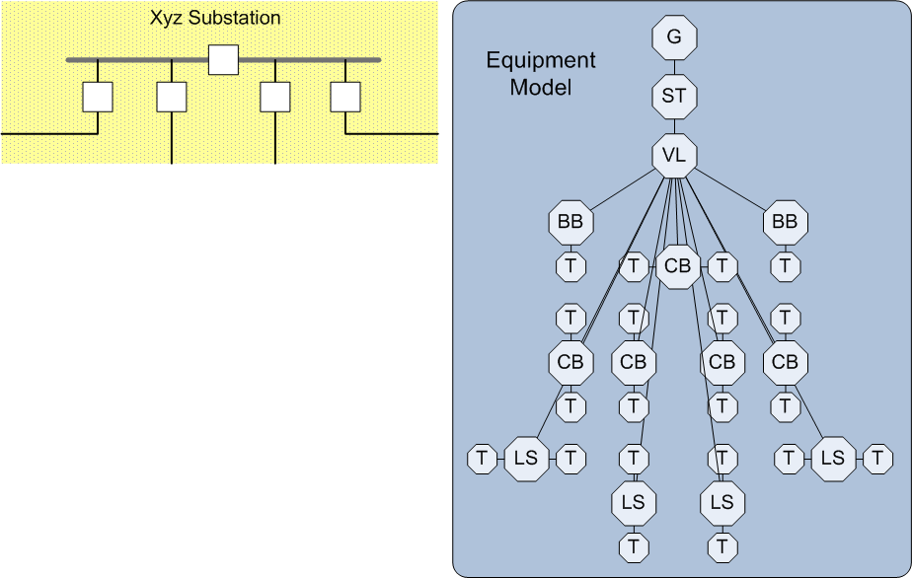
I. Normalizing Bus-Branch vs Node-Breaker Views

Slide 30
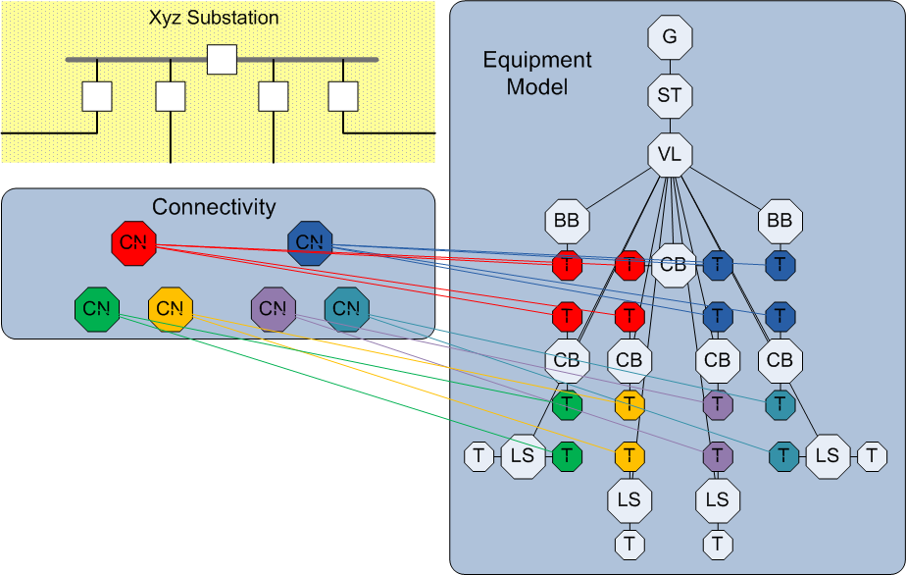
II. Normalizing Bus-Branch vs Node-Breaker Views

Slide 31
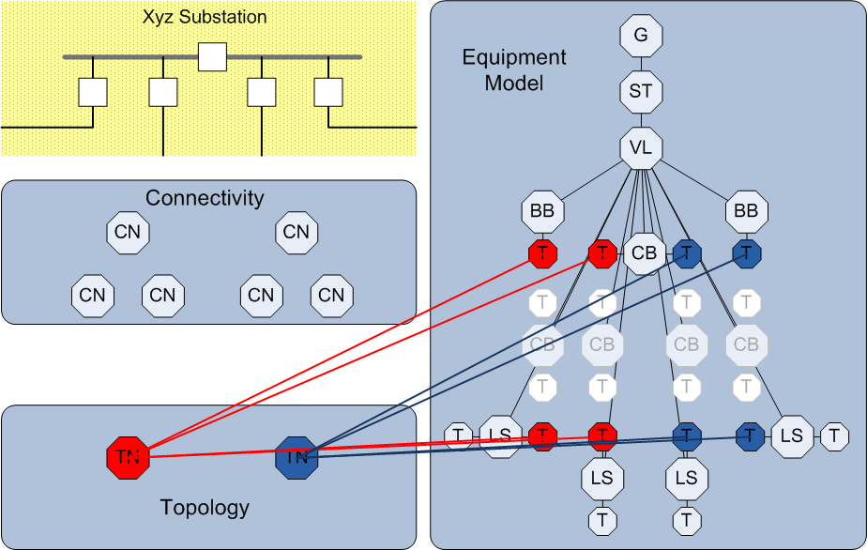
III. Normalizing Bus-Branch vs Node-Breaker Views

Slide 32
CIM Data Modularization
Partitioning by instance – ‘model authority sets’
Allows different parties to be the authority and source for different parts of the model.
Provides a means for controlling issuance of MRIDs.
Partitioning by purpose – ‘datasets’*
Distinguishes data produced by different applications (e.g. modeling vs power flow solution).
Manages the size of exchanges in high performance situations.
Provides flexibility to address different kinds of business processes with a minimum number of different standards.
* Terminology under discussion

Slide 33
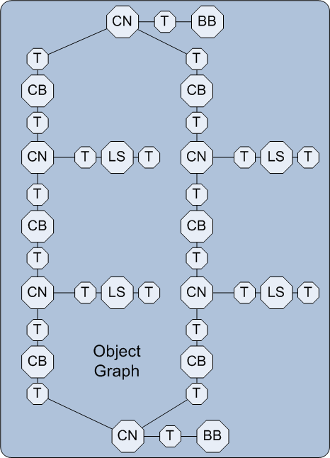
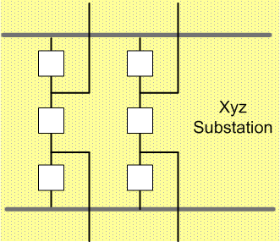
Preliminary: Expressing Data as Graphs
ST – station container
VL – voltage level container
T – terminal
CN – connectivity node
TN – topological node
BB – busbar section
LN – line container
LS – line segment
CB – circuit breaker
X – power transformer
XE – power transformer end
Objects are nodes.
Relationships are arcs.

Slide 34
Graphs can be decomposed into sub-graphs.
Any graph of objects can be modularized as follows:
Organize groups of related objects into subgraphs.
Subset of objects.
Relationships between contained objects are ‘internal’ branches.
Relationships to objects outside are ‘external’ branches.
Overall graph can be simplified as:
Represent subgraphs as single nodes.
Show only the external branches connecting subgraph nodes.
Many different decompositions are possible.

Slide 35
Model Authority Sets
Each object is in one and only one set.
Simple labeling technique for assigning responsibility.
Associations connect some objects that are in different sets.
Currently directional from n to 1 (“foreign key” convention) – under discussion.
Regional Sets:
No associations with other regional sets.
External associations to boundary sets only.
Boundary Sets:
External associations from regional sets.
External associations with other boundary sets.
A regional set may be referentially validated independent of other regional sets.
Modeling processes can proceed independently in each region.
Goal:
Maximize independence.
Design boundary sets to achieve:
Minimum data
Infrequent change

Slide 36
Typical North American Operations Boundary

Slide 37
Typical ENTSO-E Operations Boundary

Slide 38
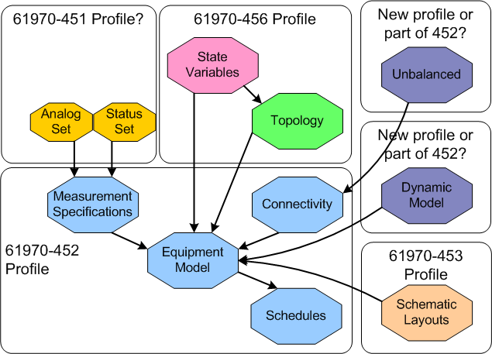
Partitioning by Purpose – ‘datasets’

Slide 39
Combining profiles into a complete solution description.

Slide 40
Dependency Relationships are Expressed in Headers

Slide 41
Example: ENTSO-E Model Partitioning into Datasets with Separate TSO Solutions

Slide 42
Example: ENTSO-E Model Partitioning into Datasets with a Single Global Solution

Slide 43
Tutorial Section III ***** CIM Network Model Exchange
Jay Britton
Britton Consulting LLC
jay.britton@comcast.net

Slide 44
The initial CIM model exchange (61970-452) standard focused only on transfer of complete EMS operations models:
CIM Exchange (full, partial, incremental update)
CIM import / export
CIM import / export
System B Import Model
System A Import Model
A
Proprietary / Homegrown Extract/Merge Tools
Proprietary / Homegrown Extract/Merge Tools
B
System A Local Vendor Model
A Internal Model
System B Local Vendor Model
B’s Model of A
A’s model of B
B Internal Model
System A EMS
System B EMS

Slide 45
Subsequent improvements provided specific support for extract / merge requirements.
Site A makes a change:
A changes its ModelAuthoritySet using its CIM modeller.
A imports the change into its EMS.
A exports the change to B.
B receives the change (full or incremental), updating A’s ModelAuthoritySet within its CIM modeller.
B renames any new elements and repeats any reduction of A’s ModelAuthoritySet.
B imports the new model into its EMS.

Slide 46
Progress in adoption has been slow.
EMS vendors and planning vendors support CIM and have tested interoperability.
However, implementation requires:
Specification of exchange procedures.
Multi-party agreement among participants.
Upgrade of tools to CIM compliance.
Testing.
Recent significant advances:
ERCOT
ENTSO-E
China
Industry change is increasing the need for effective model development processes.

Slide 47
Gaps in Present Practice
External model quality for operations.
e.g. 2008 NERC Real-Time Best Practices Report
Duplication of modeling labor.
Quality control on modeling accuracy.
Difficult to perform extract/merge operations to assemble study cases from TSO contributions.
Conflicting naming practices.
Achieving initial convergence in planning studies.
Difficult to initializing planning studies of actual system conditions recorded by EMS.
Matching operations models to planning models (bus numbering consistency).
Availability of schematic diagrams with models.
Difficult to update studies when plans change.
Increasing demand for more sophisticated models
Dynamic stability, RAS / SPS, PMU data, …
Increasing demand for more sophisticated and automated studies
e.g. ENTSO-E day-ahead cases

Slide 48
Summarizing the Problem

Slide 49
Objective: Higher quality network models as the basis for all types of analytical studies, produced and managed efficiently.
Approach
Scope
Full problem scope in view.
Establish a vision.
Utilize CIM foundation.
Incremental path to implementation.
Operations and Planning
All types of network analysis
Interconnection, local transmission, distribution views
Past, present, future time frames

Slide 50
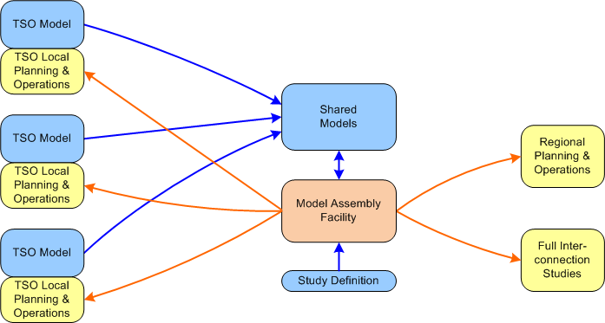
Nominal View of Required Collaboration

Slide 51
Terminology
Case. A set of data describing an initial or solved operating state (i.e. a power flow) for a network model, created as a part of a study .
Case Data Management. A system for handling the preparation of study cases made up of contributions from participant TSO members.
CIM. Common Information Model. IEC TC57 WG13 standards for exchange of power system information.
EMS. An Energy Management System – a control center with operational responsibility for bulk power for a region of the grid.
Interconnection. A bulk power grid with multiple constituent TSOs.
MAS. Model Authority Set. A subset of a network model. Used to partition models based on subsets that are produced and maintained by different modeling authorities.
Network Database. A database describing past, present and hypothetical future of the interconnection network model.
Network Model. A set of data describing the physical characteristics of the power grid.
Operating State. A set of data describing a specific condition a network model may operate in.
Operations. An organizational entity or business process with responsibility for operating a part of the power grid.
Planning. An organizational entity or business process with responsibility for planning the expansion of the power grid.
Study. A study is a set of analysis with a common purpose performed as part of a single business process.
TSO. A transmission system owner or operator – a member organization within an interconnection.

Slide 52
Problem Analysis

Slide 53
2 Important Ways to Look at the Problem
1. SEMANTICS of STATE:
Information Structure
2. PROCESSES for CHANGE:
Data Mastership / Information Flow
Create/adopt a standard information model for shared data.
Substantial model already developed.
Both planning and operations vendors participate.
How is key data made available?
What data is produced as one operation?
Who is responsible for data quality?
CIM Canonical Model
CIM profiles address exchanges identified in use cases.

Slide 54
5 BIG Facts about Network Modeling
Physical Construction Model
Defines how the network is built.
95% of all model data
Created asynchronously from studies.
Shared by all studies.
Past, present network:
Defined by construction process.
Validated by state estimation.
Plans:
Defined as result of TSO planning process.
Submitted by other participants.
Operating Hypothesis
Defines an operating hypothesis for the network.
Varies with the kind of study.
Some data come from specialized sources. For example…
Load forecasting
Market outcomes
Most data created by the participants in the analytical process.
Input or outcomes of one case are used in setup of other similar cases.
Time
The physical model has a time dimension.
Studies are based on points in time.
The entire picture evolves as new decisions are made.
Distributed Model Authority
Each TSO is the authority and source for their own territory.
Analytical models are assembled from their contributions.
Object Identification
Local naming conventions and requirements conflict.

Slide 55
1. Physical construction model

Slide 56
CIM Network Construction Model
Includes all properties inherent in the system as it is constructed:
Core Network Blueprint
Equipment role
Connectivity
Steady-state characteristics
Relationship to asset model
Schematics
Additional data
Measurements
Special protection schemes
Short circuit
Unbalanced
Standard dynamics
Custom dynamics

Slide 57
CIM Example as an Object Graph
ST – station container
VL – voltage level container
T – terminal
CN – connectivity node
TN – topological node
BB – busbar section
LN – line container
LS – line segment
CB – circuit breaker
X – power transformer
XE – power transformer end
Objects are nodes.
Relationships are arcs.

Slide 58
Is the Physical Construction Sharable? Yes!
Planners and operators typically don’t model exactly the same scope.
Solution alternatives:
Thou shalt share the same model.
Derive different models from same master model.
Who is the ‘owner’?
Probably requires cooperation
Operations manages the as-built (state estimation improves the quality)
Planners manage the plans
Each TSO manages its own territory
Bus-branch vs node-breaker models.
CIM offers solutions – see next slides

Slide 59
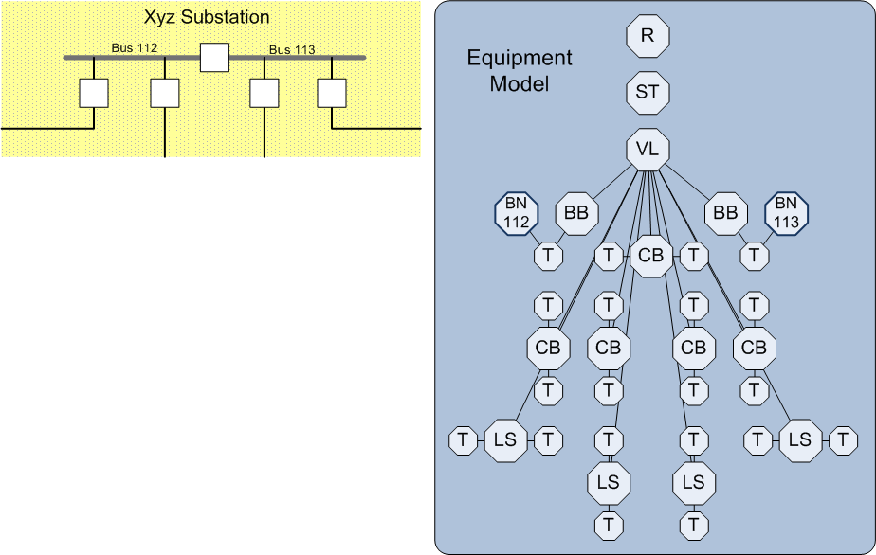
Equipment in CIM (without connectivity)

Slide 60

CIM Connectivity expresses input to topology processing

Slide 61
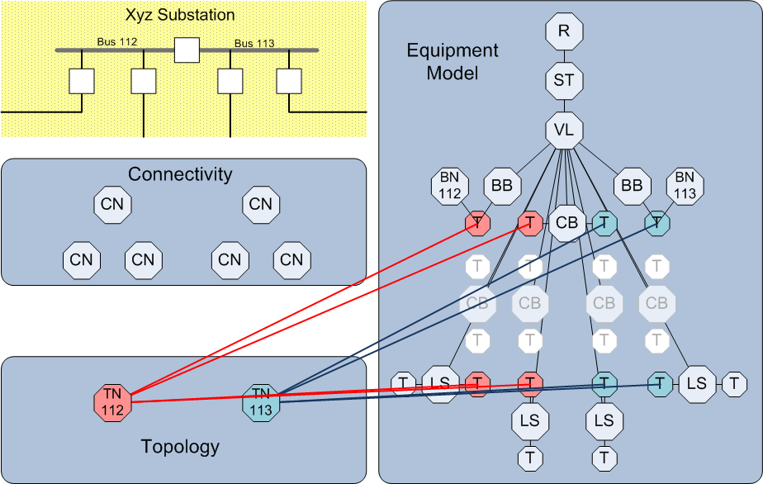
CIM Topology expresses output of topology processing.

Slide 62
Bus-branch and Node-breaker Compatibility
If only bus-branch forms are used in modeling:
Models can be directly entered in Topology form.
Topology processing can be bypassed.
CIM then mimics typical planning model detail.
If model is to be shared between operations and planning:
Source models are always in Connectivity form.
Topology processing is used to generate Topology form.
All EMS work this way.
Many planning vendors also support this now.
Connectivity form does not require full switching detail.
Any substation can be modeled with just one ConnectivityNode for each main Bus.
This is appropriate, for example, with an initial version of a planned future substation.

Slide 63
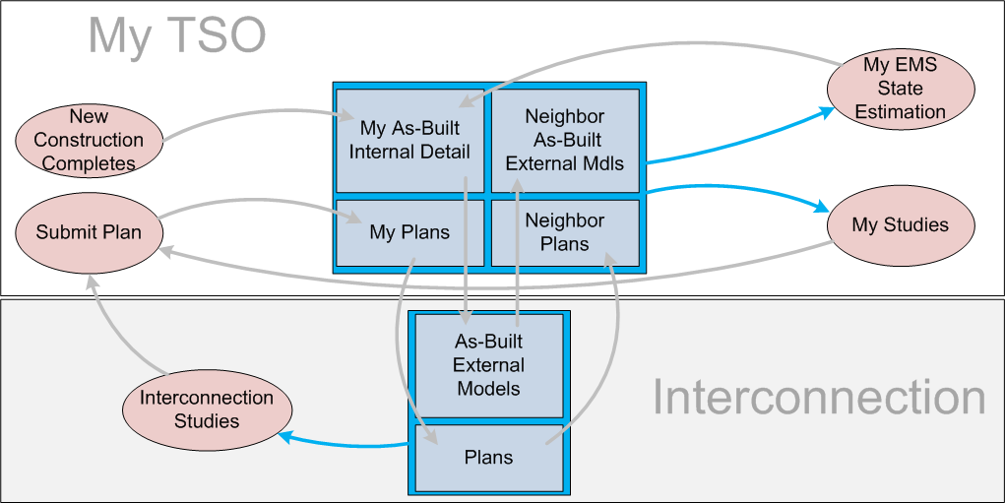
Physical network process: supporting various kinds of analytical models.

Slide 64
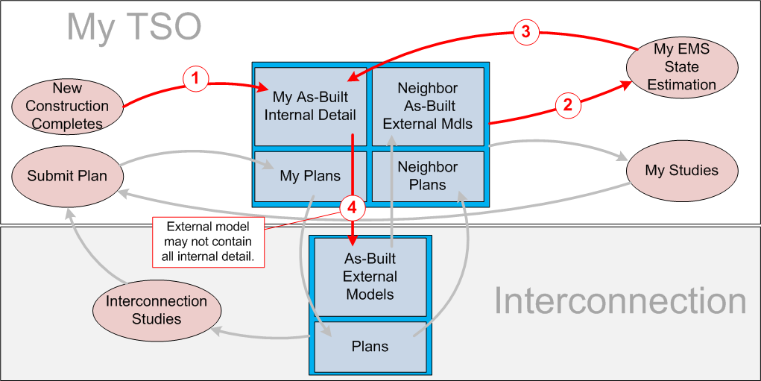
Physical network process: New Construction Completes

Slide 65
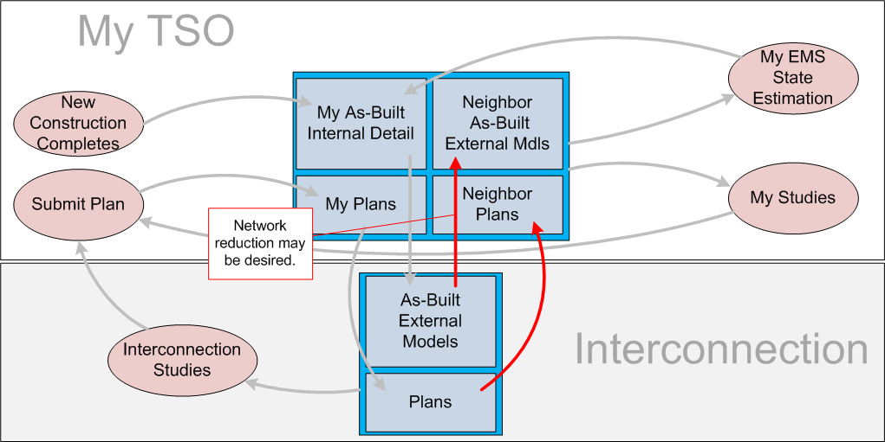
Physical network process: updating My TSO when my neighbors post new models or plans.

Slide 66
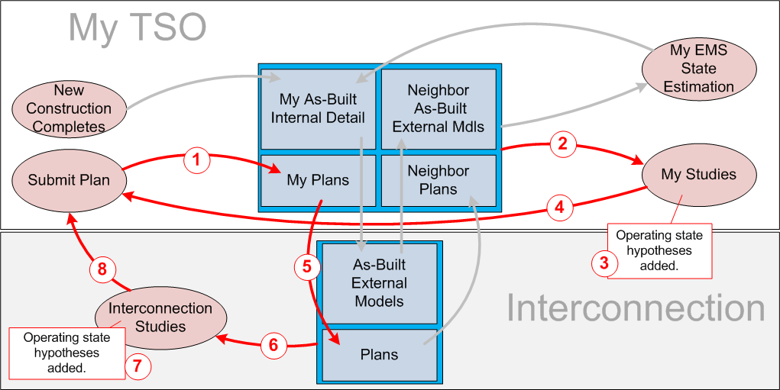
Physical network process: steps in evaluation of proposed new plans

Slide 67
61970-453 Display Layout Exchange
Purpose:
To exchange schematic display layouts accompanying model or solution exchanges.
Corresponds to the part of display maintenance work that normally goes with model maintenance.
Defines graphic objects used in the sender’s displays:
Usually linked to a model object, but can also be background.
One or more location coordinates. (Optional glue points.)
Graphic style reference.
Does not define Interpretation of graphic style references.
Usage
Sender describes diagram.
Senders disclose the way their system uses graphic styles.
Object placements describe sender’s diagram as is.
Receiver must decide how to render the diagram in its system.
Create interpretation of sender’s styles.
Receivers are not expected to duplicate functionality.
Receivers may break apart complex styles or combine simpler styles.
Receiver provides the graphic style interpretation models for their display management software.
Result:
Layouts and names of things should be familiar.
Exact replication graphically is likely only when sender and receiver applications are the same.
Exact replication functionally is likely only when sender and receiver applications are the same.

Slide 68
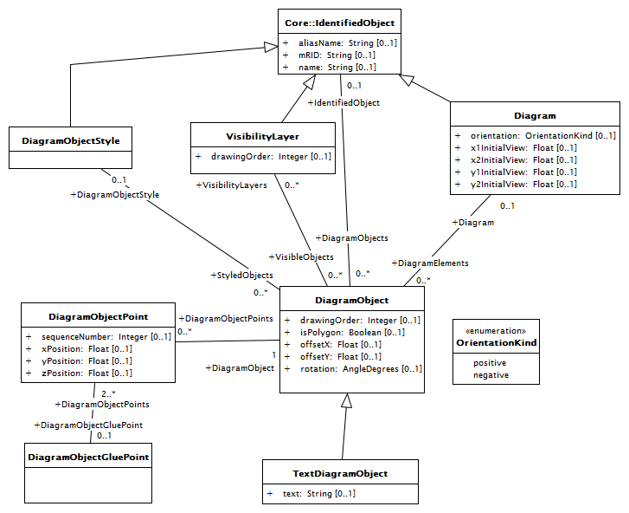
Diagram Layout

Slide 69
2. Operating Hypothesis

Slide 70
Can the Operating Hypothesis be Shared? Yes, but only happens in limited use cases.
The CIM information model for OH is the same.
Power flow algorithm is the same in EMS or planning contexts.
Key use cases require this:
Initializing planning software from past operating states.
Normal setup processes for OH data are different between operations and planning.
EMS automates OH setup based on models of operating practice.
Planning OH setup varies with the type of study.

Slide 71
Operating Practices Model – EMS Operations
For EMS, CIM provides classes that model operating practices:
Load distribution as a function of time
Generation dispatch input
Target voltage, flow schedules
Switching schedules
These enable automatic calculation of an operating hypothesis.

Slide 72
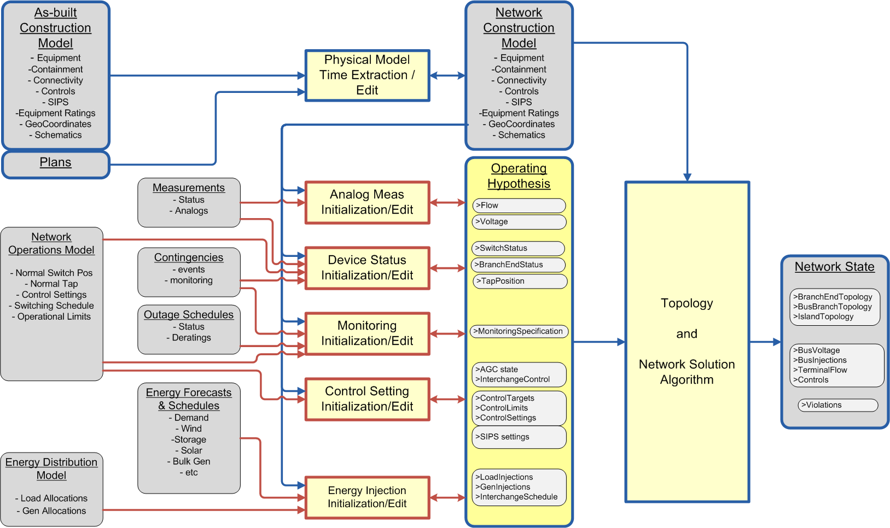

Slide 73
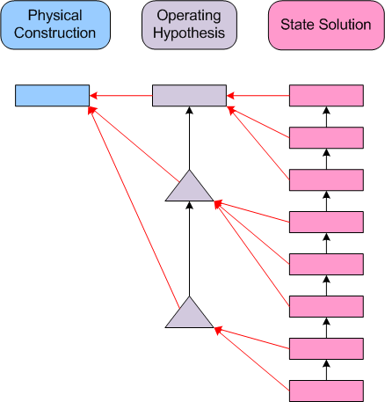
CIM dataset partitioning facilitates efficient exchange of sequences of cases.
Dependency relationships are expressed in headers.
Example:
- Exporting a sequence of state estimator results.

Slide 74
3. Model organization in CIM

Slide 75
Model Authority Sets
Partition models by instance
Each model object belongs to one and only one MAS
CIM model exchange is modularized by MAS
e.g. A model with multiple MAS is packaged as a zip of MAS files.
Exchanges of partial models where the parts (and part boundaries) are defined by MAS.
Designed to support exchange process:
A specific model authority per MAS
Mastership divided by MAS
Designed to support assembly of models:
Combine a collection of MAS to form a complete model.

Slide 76
Model Authority Sets
Each object is in one and only one set.
Simple labeling technique for assigning responsibility.
Associations connect some objects that are in different sets.
Currently directional from n to 1 (“foreign key” convention) – under discussion.
Regional Sets:
No associations with other regional sets.
External associations to boundary sets only.
Boundary Sets:
External associations from regional sets.
External associations with other boundary sets.
A regional set may be referentially validated independent of other regional sets.
Modeling processes can proceed independently in each region.
Goal:
Maximize independence.
Design boundary sets to achieve:
Minimum data
Infrequent change

Slide 77
Typical North American Operations Boundary

Slide 78
Typical ENTSO-E Operations Boundary

Slide 79
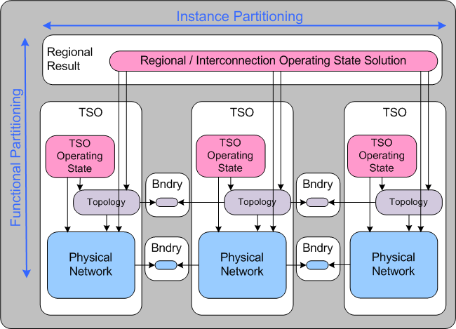
CIM Partitioning

Slide 80
More complex partitioning…
Suppose we have a multi-tier hierarchy
Interconnection level
Regional level
RTO/ISO/market types of entities
Could own transmission
TSO member organization level
HV level – electrically significant outside the TSO
LV level – locally significant

Slide 81
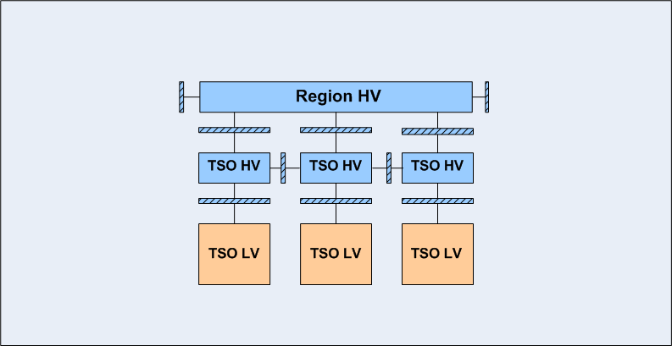
Individual Region Model

Slide 82
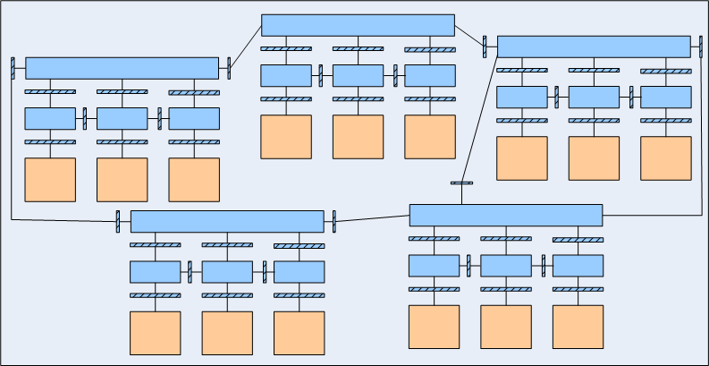
Full Interconnection Model

Slide 83
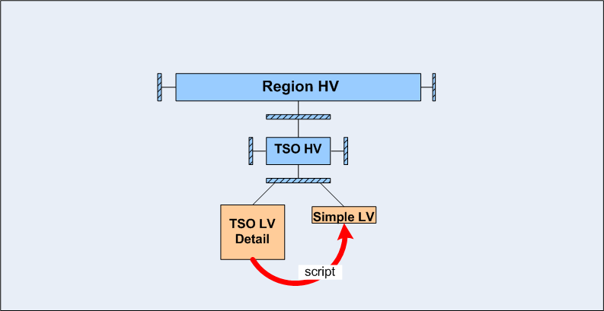
Simple State LV Models can be Derived by Script

Slide 84
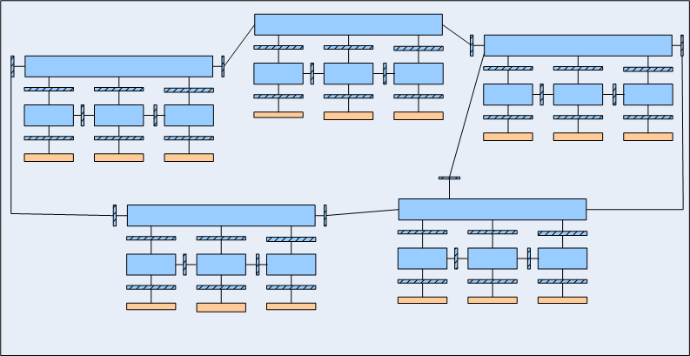
Derived National Load Dispatch Model

Slide 85
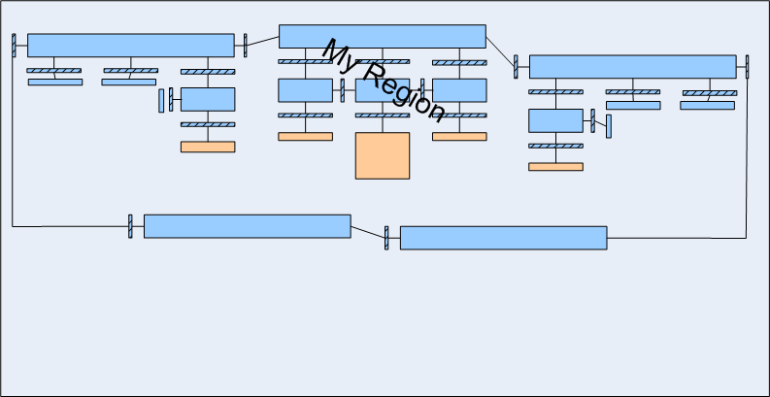
Derived Regional Dispatch Model

Slide 86
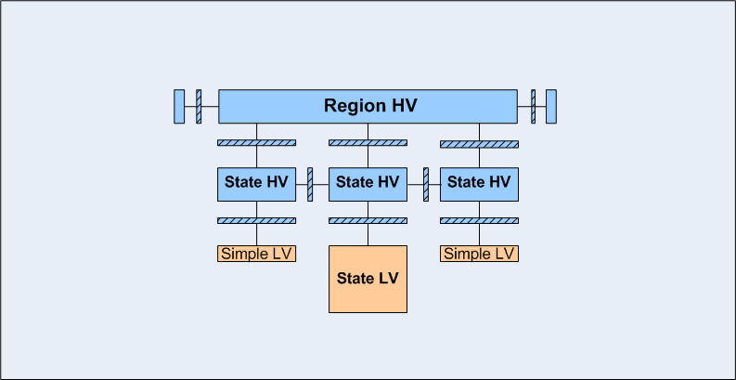
Derived TSO Dispatch Model

Slide 87
4. Time

Slide 88
Operations and Planning have similar time requirements.
Based from a current ‘as-built’ view of the system.
Past versions of as-built must be available.
Future states / hypothetical states can be assembled by adding proposed changes.

Slide 89
CIM and Time
The CIM information model describes one state of the model.
No direct provision is made for the fact that the models of a system are constantly evolving.
CIM leaves the management of timeline to applications.
CIM is about interfaces, not applications.
It was judged that no single exchange of models needed to have more than one time orientation.
However, CIM enables effective management of time.
CIM incremental specifications are appropriate for expressing a planned change for the system.
Time-related annotation may be included in message headers – this is evolving.

Slide 90
5. Object Identification

Slide 91
Two main problems…
Problem: planners rely on stable bus numbers.
Annotation of planning numbers illustrated earlier.
Problem: different names for the same objects.
Applications within a utility have different naming conventions and do not want to change.
Different utilities have different names for the same objects and do not want to change.
Software applications have different restrictions on possible names and are very expensive to change.

Slide 92
MRIDs
An interconnection modeling process must reach some mutual understanding about how to identify each modeling object.
But it is not feasible to adopt a single naming convention.
CIM solution:
Real world things are assigned a unique Master Resource Identifier, or MRID, by the ‘model authority’.
Recommended practice is to use UUIDs
Names are associated to MRIDs
Multiple names
Names can change, like attributes
Supports process where...
An MRID is assigned to a real world thing or concept by the model authority
Any computer models representing the same real world thing use the same MRID
Comparisons of cases may be made based on MRIDs.

Slide 93
The Naming Problem

Slide 94
CIM Tutorial Section -IV ******* CIM For Dynamic Models
Enamul Haq
California ISO
ehaq@caiso.com

Slide 95
Dynamic Models
Needed for dynamic system security assessment
For planning studies
For online dynamic security assessment with contingency (base case , transfer limits)
The dynamic models needed for such studies are:
Generator or Equivalent Generator models
Motors
Excitation system models , Limiters and Compensators
Governor Turbine models
Stabilizer models
Wind turbine models
Relay Models
Load Models
Transmission Device models
Remedial action schemes
HVDC and FACTS
User defined models

Slide 96
Example Dynamic Models used in WECC
Machine models
Gencc, genrou, gensal, gentpf, gentpj, genwri, gewtg, motor1
Excitation Models
esac1, easac2a, esac3a, esac5a, esac7b, esac8b, esdc2a, esdc4b, est1a, esst2a, esst4b, esst6b, exac1, exac1a, exac2, exac3, exac3a, exac4, exac6a, exac8b, exdc1, exdc2, exdc2a, exdc4, exst1, exst2, exst2a, exst3, exst3a, exst4b, exwtg1, extwge, ieeet1, pfqrg, rexs, scrx, sexs
Prime Mover Models
ccbt1, g2wscc, gast, gegt1, ggov1, ggov3, gpwscc, hyg3, hygov4, hygov, ieeeg1, ieeeg3, lcfb1, pidgov, tgov1, wndtge, wndtrb
Stabilizer Models
ieeest, pss2a, pss2b, psssb, wsccst
Transmission Device Models
svcwsc, vwscc
Load Models
alwscc, blwscc, motorw
Relay and Protection Models
gp1, lsdt1, lsdt2, lsdt9, oel1, ooslen, tlin1

Slide 97
Why Dynamic Model in CIM
Dynamic models used in the industry today are in application specific format
PSLF, PSS/E, IEEE etc .
Needs model conversion from one format to the other
Need to represent dynamic models in IEC CIM standard
Dynamic models can be shared among different applications
Dynamic Models can be shared among Utilities using CIM Standard
Needed to extend CIM to support dynamic model

Slide 98
CIM Extension for Dynamic Models
CIM Extensions support dynamic models for:
Synchronous Generator
Synchronous Motor
Asynchronous Generator
Asynchronous Motor
Voltage Compensator
Excitation System
Turbine-Governor
Power System Stabilizer

Slide 99
CIM Extension for Dynamic Models
CIM Generator Models
CIM Class “genSync” represents PSLF models – genrou, gensal, gentpf, gentpj, gencc,
CIM Class “genEquiv” represents PSLF model – gencls
CIM Class “genLoad” represents PSLF netting
CIM Class “genAsync” represents PSLF models – genind, motor1
CIM Generator Model types are
Round rotor (genrou)
Salient pole (gensal)
Transient (genrou)
Type F (gentpf)
Type J (gentpj)

Slide 100
CIM Extension for Dynamic Models
CIM class for Synchronous motor “motorSync”
Synchronous motor type “round rotor” (PSLF - genrou)
Synchronous motor type “salient pole” (PSLF - gensal)
CIM Class for Asynchronous motor – “motorAsync” (PSLF - motor1)
CIM Class for IEEE Voltage Compensator Model - “VcompIEEE” (PSLF – Rcomp, Xcomp)
CIM class for Cross compound voltage compensation model - “VcompCross”
CIM classes for IEEE Excitation Systems
ExcAC1, ExcAC2, ExcAC3A, ExcAC4A, ExcAC5A, ExcAC6A, ExcAC7B, ExcAc8B, ExcDC1A, ExcDc2A, ExcDc3a, ExcDc4B, ExcSt1A, ExcST2A, ExcST3A, ExcST4b, ExcST5B, ExcST6b, ExcSt7B
CIM class for Simplified Excitation system model with field discharge resistor – “ExcSCRX” (PSLF – scrx)
CIM Class for simplified excitation system model – “ExcSEXS” (PSLF – sexs)
CIM class for IEEEPSS2B power system stabilizer – “PssIEEE2B” (PSLF- pss2b, pss2a)

Slide 101
CIM Extension for Dynamic Models
Dynamic Models for Governor
CIM class for Hydro governor model – “GovHydro1” (PSLF - hygov)
CIM class for simplified steam turbine governor model – “GovSteam0” (PSLF – tgov1)
CIM class for IEEE steam turbine governor model – “GovSteam1” (PSLF – ieeeg1)
CIM class for PID governor and prime mover model – “GovCT1” (PSLF – ggov1)
CIM class for IEEE hydro turbine governor model that represents plants with straight forward penstock configuration and hydraulic dashpot governors – “GovHydro2” (PSLF – ieeeg3)
Dynamic Models for Load
CIM class for bus static load – “LoadStaticBus” with type ZIP1, ZIP2 (PSLF – blwscc)
CIM class for area static load model – “LoadStaticArea” with type ZIP1, ZIP2 (PSLF – alwscc)
CIM class for system static load model – “LoadStaticSystem” with type ZIP1, ZIP2 (PSLF – wlwscc)
CIM class for aggregate induction motor load _ “LoadMotor” (PSLF – motorw)
CIM class for mechanical load model1 – “MechLoad1” (PSLF – apfl, spfl)

Slide 102
Dynamic Model Interconnection

Slide 103
Control Blocks in Dynamic Models
Standard Dynamic models are comprised of:
dynamic Control Blocks performing standard types of functions
combined in standard Interconnection Patterns
Control Block Types
Are “black boxes” - representing piece of self-contained dynamic behavior
Include:
Synchronous Generator
Synchronous Motor
Asynchronous Generator
Asynchronous Motor
Voltage Compensator
Excitation System
Turbine-Governor
Power System Stabilizer
Load Model

Slide 104
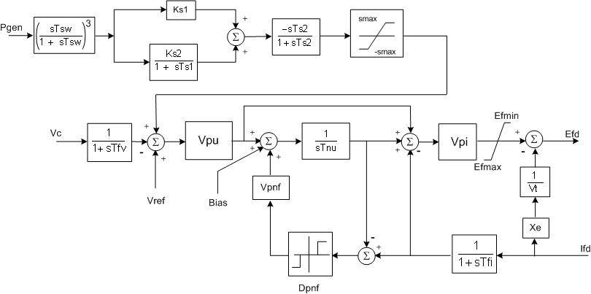
Control Block in Dynamic Model
Have standard inputs and outputs and standard initialization assumptions
Can be many, many standard models (control Blocks) of a given control block type
Behavior described by a diagram that has specific parameters to allow tailoring the behavior for a specific piece of equipment , like this excitation system model

Slide 105
Current Status of Dynamic Model
Status of Dynamic Models
130+ standard models identified, documented and being entered into UML
UML driven documentation for dynamic model
The area of dynamic models is very large and complex and it will be an on going effort
Future Work
Include more standard models in CIM Dynamic models
Dynamic model for DC
Dynamic models for FACTS
Remedial action schemes
User defined models (more work needed)
Dynamic models for distributed resources (solar, Fly wheel, battery etc)
Wind generation models
Protection device models

Slide 106
Tutorial Section V ***** CIMocracy: Overview of the CIM Standards
Margaret Goodrich
SISCO
margaret@sisconet.com

Slide 107
Introduction
The Business Case for Standards
What Utilities Need
How Standards Can Help
Standards Bodies – What are they/What they Cover
CIM User’s Group

Slide 108
Business Case for Standards
Main reasons for Standards:
Eliminate Captive Client Syndrome (Price/Schedule Options)
Deregulation/Re-regulation
Integration Upgrade Path
Best of Breed Applications
Data Exposure
Primary Issues surrounding Data Exchange
Proprietary formats
Larger Models for Security and Reliability

Slide 109
What Utilities Need
An integration framework:
Need to integrate applications in EMS
SCADA, Alarm Processing, Network Applications, Historian, etc.
Need to integrate new and legacy systems in T&D:
EMS/SCADA systems, Planning, Asset Management, Outage Management, GIS, Planning Systems, etc.
Leads to enterprise-wide integration strategy
A standard way to exchange information with other utilities/ISOs for security,open access, energy markets:
Need common power system model
Need common information exchange format
Need common data naming and typing

Slide 110
How Standards Can Help
Support information exchange between systems supporting business functions for planning, constructing, maintaining and operating the electric transmission and distribution (T&D) network
Common Models (CIM) for understanding information:
Consistent meaning and organization of data into objects and attributes
Common operations or methods (GID) to share information:
Request data from distributed databases
Send messages with updates to distributed databases

Slide 111
What is the IEC
IEC is International Electrotechnical Commission
It is the Governing Standards Body used by our industry.
Within IEC there are Technical Committees (TC) and the Utility Group is number 57 (TC57)
There is a Reference Architecture document for TC57 that describes the full enterprise that is encompassed within TC57
TC57 then has Working Groups for each area of the Architecture:
WG13 - Transmission
WG16 - Markets
WG14 – Distribution
WG21 – Retail Markets, Home Smart Grid
WG19 – Harmonization
Each WG has a set of numbers that are used to “name” the standars they generate, e.g., 61970-301)
Notes:
111

Slide 112




TC57 Organization & Formal Liaisons
WG19 Architecture
UCA International User groups
WG13 EMS-API
WG 10 Substation Automation
CIM/61850 Harmonization
CIGRE SC D2-24 SC B5-38
WG14
SIDM
WG17 DER
TC57
WG16 Energy Markets
WG18 Hydro
IEEE PES PSCC Security SubComm
Legend
WG3 Telecontrol Protocols
WG20 Power Line Carrier
CIM-based
WG15
Security
61850-based

Slide 113
TC57 Reference Architecture

Slide 114
61970 – Transmission
Legacy
System
Alarm
Topology
Network
PI-Historian
Accounting/
Generation
Processor
Processor
Applications
Settlement
Control
SCADA
Legacy
Network
SCADA
Programs
Programs
System
Programs
Programs
CIM Server
Programs
Legacy
Public
Public
Public
Public
Public
Public
Wrapper
Data
Data
Data
Data
Data
Data
Integration Bus or Network w/Protocols
User
Distribution
ICCP
Public
PCs
Management
Public
Network
Data
Systems
Data
Programs
Component
Programs
Interface
ICCP

Slide 115
61968 - Distribution

Slide 116
62325 – Reference Model

Slide 117
CIM User’s Group (CIMug) Mission
The CIM Users Group is dedicated to managing and communicating issues concerning the TC57 IEC 61970, 61968 and 62325 standards and to serving as the primary means for developing consensus and consistency across the industry.

Slide 118
CIMug Activities
Provide liaison with other standards groups and assess the impact of other standards on the form, scope and content of the CIM
Provide a central Repository for CIM issues, models, messages, and expertise
Promote the CIM, GID and other IEC TC57 standards
Provide a single point of contact for CIM Model Management and issue resolution.
Provide awareness of CIM products and implementations
Provide a Help Desk

Slide 119



CIMug is part of UCAiug
61850
http://cimug.ucaiug.org/default.aspx

Slide 120
Volunteer Opportunities
Conference Planning
Service Rep – Help Desk Coordinator
Site Coach – Sharepoint Assistance
Knowledge Manager – Librarian for FAQs and Knowledge Base
Expert – Respond to Help Desk Requests
Marketing – Booth, Demonstrations, Branding, etc.
Member Communications – Plan development and implementation

Slide 121
Tutorial Section VI ***** Information Modeling
Margaret Goodrich
SISCO
margaret@sisconet.com

Slide 122
Introduction
Information Modeling Methodology
The Common Information Model (CIM)
Overview
CIM UML Packages
UML Basics

Slide 123
IM Methodology
Information Modeling is a disciplined approach to the development of industrial grade software based on the object oriented paradigm.
Projects using this methodology have produced manufacturing and process control applications, intelligent instruments and peripherals, telecommunications and defense applications.

Slide 124
IM Methodology
An abstract representation of real-world objects
Gives unique names, definition and meaning to each object to avoid confusion
Describes relationships between objects
Not tied to a particular application’s view of the world
But permits the same model to be used by all applications to facilitate information sharing between applications
Provides consistent view of the world by operators regardless of which application user interface they are using

Slide 125
IM Components
An Information Model is composed of Packages that describe distinct subjects.
Each of the Packages describes the classes and the relationship of the classes for that subject.
A Class describes an object, its properties or attributes and the relationships with other objects or classes
An attribute is an element of the class. For example, the r value is an attribute of an AC Line Segment
A relationship defines the association of the class to other classes or attributes:
transformers are contained within substations
transformers have names, voltages, ratings, etc.

Slide 126
Benefits of Information Models
Models give context to data that improves understanding and productivity.
The information contained in the model enables automation of setup and maintenance tasks.
Model aware applications can be made independent of the data.

Slide 127
CIM - What It Is -- And Isn’t
CIM = Common Information Model
CIM is:
A model defining classes and their relationships to other classes
CIM is not:
a database (object or relational)
Specifies relationships, not how you store them
Notes:
This is self-explanatory

Slide 128
The Common Information Model (CIM)
An information model representing real-world utility objects (or classes) found in transmission and distribution operation and management
Includes classes (i.e.objects), their attributes and relationships between classes/objects
A tool to enable data access in a standard way
Inspiration for logical data schemas to build databases (e.g., for an operational data store)
Common language to navigate and access complex data structures in any database. It provides a hierarchical view of data for browsing and access
To define information exchange models
A tool to enable integration of applications/systems
Provides a common language for exchanging messages or models between systems

Slide 129
CIM Overview
Each package and class is represented in the CIM Standard document using:
Diagrams
Text containing the attributes with a description and a list of its parameters
Each Package contains a set of object/classes
Each object/class is defined in terms of:
Attributes
Relationships (associations both within and between other packages)

Slide 130
CIM Overview
A Power System Resource (PSR) is a class that represents an asset within the Utility
i.e. a Generating Unit, a Line Segment, a Transformer
Attributes describe the PSR:
For AC Line Segments attributes are the serial numbers, spatial positions, length, voltage, etc.
For Capacitor Banks it is the impedance, max/min kV, etc.

Slide 131
CIM Overview
The Relationship is either:
Connected To
Member Of
Owned By
Measured By
Has A
Etc.

Slide 132
The Common Information Model Defines
Power System Resources, Attributes and Relationships
Company
Generator
Control Area
Operates
Controls
Supplies
Energy for
Provides
Transmission for
Busbar
Connects to
Load
Connects to
Company
AC Line
Connects to
Owns

Slide 133
CIM – Top Level Packages

Slide 134
61970 (Transmission) Packages

Slide 135
61968 (Distribution) Packages

Slide 136
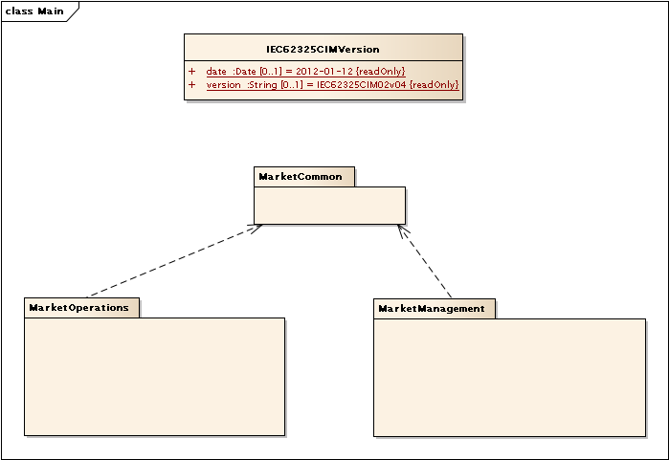
62325 (Markets) Packages

Slide 137
The CIM Is Expressed In Unified Modeling Language (UML) Notation
A Bit On Unified Modeling Language (UML) Notation
Class Name usually describes things in the real world
Class Attributes describe
significant aspects about the thing
This Specialization indicates that a “Pole” is a type of “Structure.” Since a “Structure” is a type of “Asset,” the Pole inherits all of the attributes from both Structure and Asset
Associations connect classes and are
assigned a role that describes the relationship

Slide 138
UML Concepts: Generalization/Specialization/Inheritance
Breaker: Specialization of Switch
Switch: Specialization of Conducting Equipment
ConductingEquipment: Specialization of PowerSystem Resource
Going is reverse, these are referred to as Generalizations
Each specialization inherits all the attributes and associations of the generalized object above it.

Slide 139
UML Concepts: Simple Association (aka Relationship)
Tap Changer has 0 or 1 regulation schedules
Regulation Schedule applies to 0 to n Tap Changers
This is a one-to-many relationship/association

Slide 140
UML Concepts: Aggregation/Composition (aka Containment)
TopologicalIsland
TopologicalNode
1
1.. n
A Topological Island comprises 1 to n Topological Nodes
Topological Nodes are Contained within Topological Islands
Black Diamond – Composition White Diamond – Aggregation
Child cannot exist without parent Child can exist without parent
Diamonds always point to the parent or “whole” part of the relationship. Implied multiplicity of Parent is 0..1 unless specified as 1. The Child is fully contained within the parent – it is a “part” of the whole.

Slide 141
Equipment Inheritance Hierarchy

Slide 142
Equipment Containers (Containment)

Slide 143
Transformer Class (Model) From CIM
Notes:
OK, increase font size

Slide 144
Transformer End Attributes

Slide 145
Connectivity Model

Slide 146
Names
Object naming is an important aspect of integration that is often overlooked
Issues:
The same object may be known in different system by different names
Messages need to use an identified that is known by source and targets
Some systems may need to be aware of multiple identifiers for a single object (e.g. local ID and external ID)
Sources and targets MUST agree upon names to be used, or rely upon the use of bilateral mapping tables for object names
A naming service could be used for allocating and managing names
The performance implications of name lookups needs to be carefully considered
Name class introduced in CIM v15 to help address these issues

Slide 147
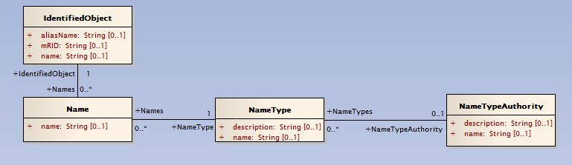
CIM Name Class
Identified Objects can have many Names
Each Name.name instance can be associated with a different NameType
NameTypes can be associated with a NameTypeAuthority that can be responsible for allocating Name.name values within a NameType
IdentifiedObject.name preserved for legacy reasons

Slide 148
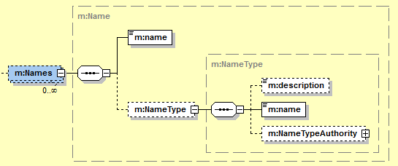
Names in Messages
Common usage of Name class in a message XSD
NameType often option, but should be provided by source if more than one Name instance provided
Target process will map the object using one of the names, as the name is either used locally or defined within a bilateral mapping table

Slide 149
Name Mapping Example
Source sends a message related to object ‘ABC’
Within message Name.name value is set to ‘ABC’
Name.NameType.name can be used to specifically identify the type of name
External ID | Local ID
ABC | 1
XYZ | 2
RTY | 345
INB | 67433
MJG | 222
ECV | 555
GGG | 225
Target receives the message
Given that the Name.name value is unknown, a table lookup is required to known that ‘ABC’ as provided by the external system is equivalent to ‘1’
Note: This is one example, there are many options

Slide 150
UML Element Conventions
Packages
Before creating a package, search for intended package name and add a prefix if the package already exists
Create a package that is peer (sibling) to the IEC* packages, e.g., MyPackage
Create a class within that package called MyPackageCIMVersion and copy date and version attributes from IEC61970CIMVersion into it and update the values to fit your context
If there are a large number of class extensions, create sub-packages within MyPackage
Document each package with a sentence or two

Slide 151
UML Element Conventions
Classes
before creating a class, search for the intended class name and add a prefix to the extension if a class already exists
class names start with upper case and should not end with 's‘
document the purpose of the class
Use TagValues or Stereotypes: enumeration, Datatype or Compound (you should not be defining other Primitive types than standard ones)
Stereotyped classes are types that never participate in relationships (i.e., no associations, no inheritance), but are used as types for attributes

Slide 152
UML Element Conventions
Classes (Continued)
Datatype may have attributes whose types are Primitive or enumeration (example: IEC61970::Domain::ActivePower)
Compound may have attributes whose types are Primitive, enumeration, Datatype or Compound (example: IEC61968::Common::StreetAddress)
Never use association class (too exotic UML feature, poor tool support)

Slide 153
UML Element Conventions
Attributes
Attribute names start with lower case and should not end with 's‘
Document the purpose of the attribute
Change default multiplicity - all attributes in CIM are optional
Set default Private visibility to Public - all attributes in CIM are public
When choosing type, ensure you select it from the list of types. Attention on Primitives: use CIM Primitive datatypes (e.g., String, Boolean), not default UML ones (string, boolean)
Inherent dependency between the attribute's type and the class owning the attribute is uni-directional: Class knows about the attribute's type, but not vice versa

Slide 154
UML Element Conventions
Associations
Important: draw the association from your extension class towards a standard CIM class and never vice versa
Ensure you specify multiplicity for both association ends ([1], [0..1], [1..*] or [0..*])
Ensure both ends have navigability 'unspecified‘
Give names starting with upper case to both association ends; if multiplicity ends with * (i.e., more than one), append 's' to that association end name

Slide 155
UML Element Conventions
Associations (Continued)
Document the purpose of each association end (avoid "A is related to one or more B" - UML shows it already)
For WG14: avoid aggregation (we currently have none); for WG13: aggregation has special meaning in the context of naming hierarchy for PowerSystemResources
Inherent dependency between the two classes participating in association is bi-directional: Both classes know about each other
Minimize associations from extension classes to high-level standard CIM classes - try to add association between your extension classes that derive from standard CIM classes

Slide 156
UML Element Conventions
Inheritance
Stereotyped classes never participate in inheritance
CIM does not allow multiple inheritance
Existing standard CIM classes can be used as supertypes for your extension classes, never vice versa
Inheritance is the strongest possible dependency; it is often misused and should be used with care (note: everything that can be expressed through inheritance could also be expressed through composition)

Slide 157
Package Dependency
No UML tool currently draws dependencies automatically (although they could)
UML tools sometimes use explicit dependency relationship in strange ways during model merges, therefore the importance of what are source and target ends
IEC61970 (base CIM) must NOT depend on anything
IEC61968 depends on IEC61970 and nothing else
Important: draw the dependency from your extension package(s) towards standard CIM package(s) and never vice versa
Currently, top-level packages other than those starting with IEC are obsolete - do not use classes from them, as they will be replaced with a package of WG16

Slide 158
Tutorial Section VII ***** From Canonical Semantics to Interoperability Profiles
Jay Britton
Britton Consulting LLC
jay.britton@comcast.net

Slide 159
What are the keys to simplifying integration?
Communication methods:
E.g. Pub sub; enterprise message bus; …
Syntactical constructions with marshalling / unmarshalling tools:
E.g. XML
Semantic organization:
Canonical data models; standardized semantic interoperability; …
Business process organization:
…
Application investment is highly dependent on semantic choices.

Slide 160
GWAC Stack from Gridwise Architecture

Slide 161
Important terminology…
Semantics refers to the meaning of a set of information.
A semantic model is a structured description of the semantics of a set of information, using some information modeling language (e.g. UML).
A semantic model is ‘metadata’ – ‘data about data’.
Many different semantic models are possible for the same semantics, even within one modeling language.
Semantic modeling only represents information content – it does not include formatting/encoding (syntactical) specifications.
A semantic transformation is a procedure for converting a given semantic from one semantic model representation to another.
This should be distinguished from a syntactic transformation that converts from one format to another. (e.g. CSV to XML)

Slide 162
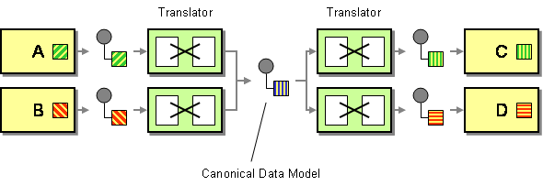
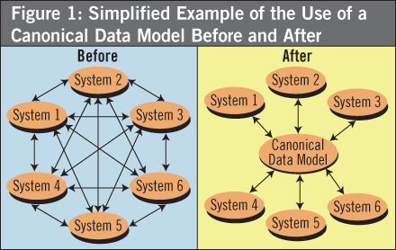
A canonical data model (CDM) is a semantic model chosen as a common dialect for a data exchange.
Unification of semantic integration standards occurs when profiles specifying individual exchanges derive their semantics from a common CDM.

Slide 163
Profile
A specification for a data exchange in a particular business context.
Semantic content defined as a subset of a CDM.
Interface media defined. E.g File, message, data server, etc.
Serialization / access mechanism defined as appropriate.
If appropriate, message exchange sequences defined.
Implementation investment is in profiles, not the CDM.
Testing occurs at the profile level, not the CDM.
Compliance is defined at the profile level, not the CDM.

Slide 164
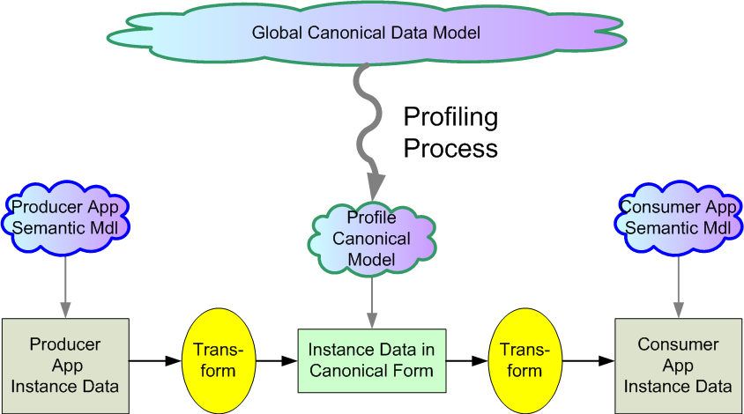
Transformations connect local semantics to standard profile semantics derived from CDM.
e.g. CIM

Slide 165
How does a standard profile get started?
The process starts with a business problem:
A need is identified for standardized interaction among a group of applications to accomplish some business purpose.
And organizational questions…
What is the proposed scope/purpose of the business problem?
Who are the interested parties that will supply domain expertise and develop the technical specifications?
What parties are expected to implement support for the standard?
Which CIM group will take responsibility?
IEC formalities to define new work item (NWIP).
This basically creates a community of interest.
Use cases drive requirements.
Individual data exchanges are identified which must be profiled.
Often a given business problem involves multiple exchange profiles.

Slide 166
Profile dependence
Profile B is semantically dependent on profile A if the content of B cannot be fully interpreted without the content of A.
Example:
Profile A defines the equipment making up an electrical network.
Profile B defines a list of contingency specifications that reference equipment to be outaged.

Slide 167
Example of Interdependent Profiles

Slide 168
Export of a series of state estimator results.
Dependency relationships (arrows) are expressed in headers.

Slide 169
ENTSO-E Day-Ahead Congestion Forecast Process: TSO submits a sequence of 24 hourly cases each day.
Dependency relationships (arrows) are expressed in headers.

Slide 170
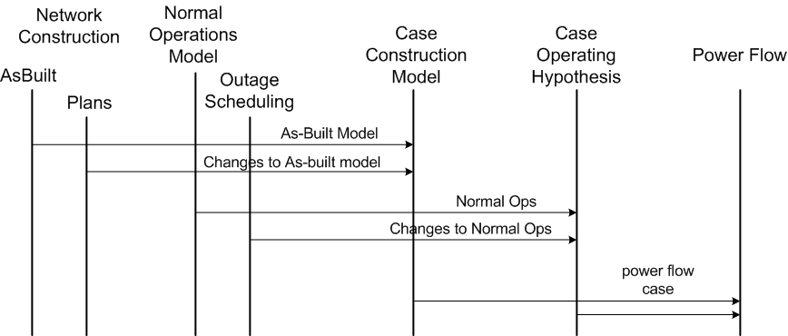
Partial Sequence Diagram for Building Power Flow Cases

Slide 171
Enterprise CDM Practicalities
Versions
Industry standard CDM aims at consistency among a family of standards.
As new standards are developed each year, a new version of the CDM is released.
It is impractical to update all previous standard profiles whenever a new CDM version is released.
Variants
When vendors or utilities use the standard CDM to achieve semantic consistency, they inevitably need to extend / adapt the core CDM. This is called a CDM variant.
Utility application also proceeds in stages, it requires regular update to new versions of the variant.
It is impractical for any utility to maintain all implementations at the latest version of their variant.
Consequence:
Enterprise usage of CDM strategy will never achieve complete consistency.
CDMs are never complete, never final – just like real languages.

Slide 172
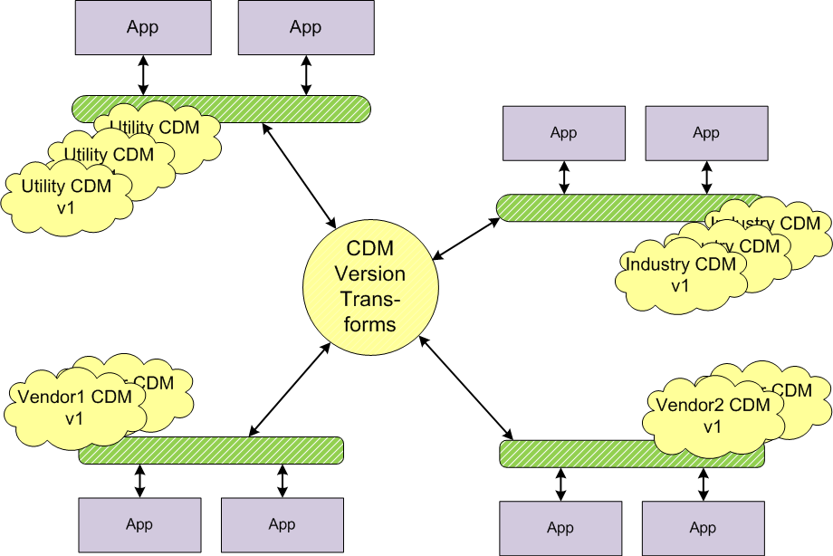
Enterprise CDM Versions & Variants

Slide 173
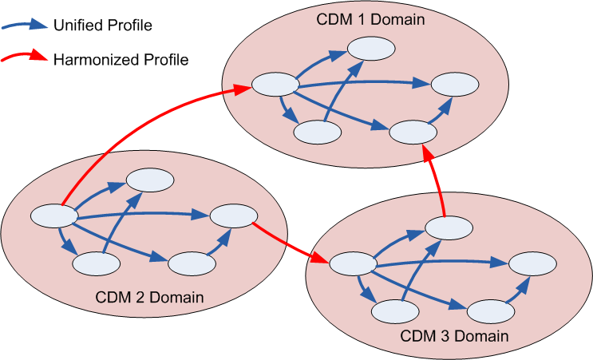
And there is not just one CDM…

Slide 174
Harmonization: the next best thing for coordinating CDMs.
Definition: two CDMs are harmonized if:
There is a lossless transformation defined between all duplicated semantics.
Both sides undertake to maintain the harmony, once established.

Slide 175
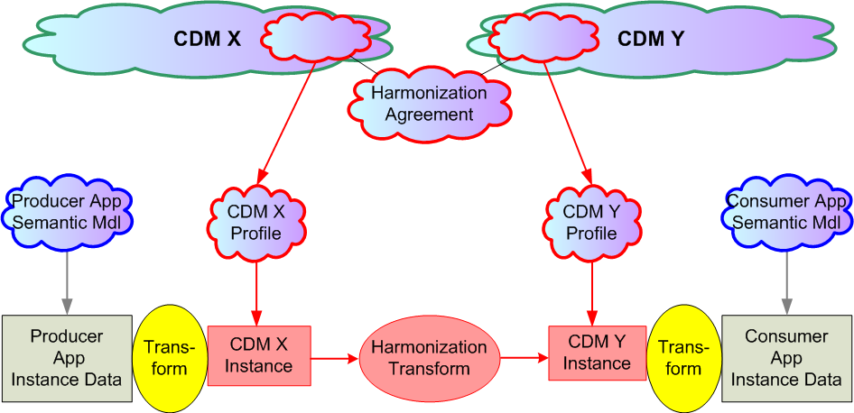
Standard semantic integration between harmonized domains – two CDMS.

Slide 176
Tutorial Section VIII ***** Extending the CIM
Margaret Goodrich
SISCO
margaret@sisconet.com

Slide 177
Using the CIM
The CIM can be used in many ways:
Where it is the basis of a predefined, standard exchange profile or interface definition
To extend an existing standard profile or interface to meet local requirements
Where it is used to create new exchange profiles and interfaces where standards do not exist
For items 2 and 3 above, it is often necessary to extend the CIM
The way in which the CIM is extended and profiles defined must be carefully considered

Slide 178
Introduction
Process to Correct Errors
Process to Extend the CIM
Steps to Implement one or more Extensions
Complete Process steps
Implement extensions in a UML Packaged
Implement extensions in UML Elements within Standard Packages (Non-Packaged Based Extension – Two Possibilities)
Submit to IEC
Summary

Slide 179
CIM Correction Process
Identify the Error or Issue
Generate a CIM Issue Submission Form and submit it to the CIM User’s Group
The Request will be reviewed for possible correction or resolution
The CIM Model Manager will reply to your Request

Slide 180
Process to Extend the CIM
The Process to implement one or more individual extensions to the CIM standard includes the following steps:
Define a Use Case (Identify the objectives and data/work flow)
Identify the Data required to satisfy the use case (Data Requirements – Profile or other document)
Identify where and how the data extension could be inserted into the model and Implement the change in UML
Generate the Profile(s) Using a Profile Generation Tool
Submit to IEC with a CIM Issue

Slide 181
Use Case: Definition
A Use Case is a document that Identifies the Objective.
A template or form is used to assist in the definition.
This template contains the following sections:
Summary
Actor(s)
Probable Participating Systems or Business Functions
Pre-Conditions
Design Considerations
Know Assumptions, limitations, constraints, or variations
Normal Sequence (workflow)
Exceptions/Alternate Sequences
Post-Conditions
References
Issues & Revision History
Sequence Diagrams

Slide 182
Use Case: Section Description
Summary – this section describes the objective of the Use Case – example: need to transfer model data for network changes
Actors – Defines the people or departments that have a role in the implementation of the objective – normally this is the end users such as the modeling engineer
Participating Systems – Defines the Systems or Departments/Companies involved in implementing the process or software to meet the objective – ex. Network Applications or the Reliability Coordination department
Pre-Conditions – Defines the conditions or capabilities that must be in place for the solution to be used – ex. there is an existing model that can be exported in a standard format.

Slide 183
Use Case: Section Description
Design Considerations – Defines the assumptions and design issues that must be included in the implementation – ex. Real-time network data will be obtained via ICCP.
Known Assumptions, Limitations, Constraints – Identifies the variables that may affect the objective’s solution – ex. Frequency of use, sizing characteristics, etc. are defined in this section.
Normal Sequence – Outlines the steps or business processes that will be required/used to implement the solution – ex. Identifies who makes the request and how, where and how the request is routed, etc.
Exceptions/Alternate Sequences – Describes any alternate actions required that deviate from the normal sequence
Post-Conditions – Defines what is expected or what actions must be taken after the solution is implemented – ex. Once a model transfer is received it must be merged into the updated model.

Slide 184
Use Case: Section Description
References – Lists any documents or other use cases that may provide additional information surrounding this use case.
Issues – Lists any issues that may need resolution prior to the implementation of the use case.
Revision History – Identifies the revision of this document, who created the revision and what was changed.

Slide 185
CIM Extension Methods Using UML
Perferred method is to put the extensions into a separate model file in conjunction with the above methods – known as Package Based Extensions
Extensions can be directly applied to a given CIM release, in terms of new classes, attributes and associations
There are two ways to identify the extensions within a UML model file:
Stereotyping
Tagged values

Slide 186
Package Based Extensions
The easiest method to identify extensions is to place all UML elements in a UML Package
In addition, this method allows easy integration of the changes into the full domain model by the CIM Model Manager
The EA UML tool allows the import and export of individual packages and their sub-packages

Slide 187
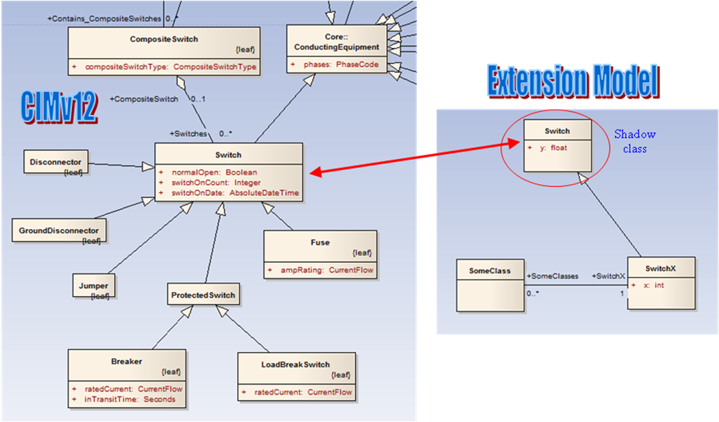
CIM Extensions: Extension Models
Extensions can be put into a separate file

Slide 188
Directly Applied Extensions
If this method is used, must provide a mechanism to identify the extensions.
There are two ways to accomplish this:
Stereotyping
Tagged values

Slide 189
Directly Applied Extension - Stereotype
Use of Stereotyping Functions in EA
Use <<extension>> as the label for custom top-level package
Use <<name>> as the label for each new class or attribute added to an existing CIM package where name designates the entity or project that needs the extension. For example - <<SG-RTP>> or the name of the entity.

Slide 190
Directly Applied Extensions – Tag Values
Use Tagged Value Function in EA
Tagged Values may be preferred over Stereotype since EA allows simple viewing using the “View | Tagged Values” feature
Tagged Values may be added to both Attributes and Associations
Tagged Values is the method already used by CIMTool to manage namespaces in UML

Slide 191
Submission to IEC
Prior to submission of a profile to the IEC the following must be completed:
Development of a set of Use Cases
Definition and Generation of a Profile or other document
Generate the UML diagrams for the extensions to the standards
This ensures the standard is defined in sufficient detail to be implemented.

Slide 192
Tutorial Section IX ***** Instance Identification
Alan McMorran
Open Grid Systems
alan@opengridsystems.com

Slide 193
What’s in a Name?
A common semantic model moves data from being application-centric to enterprise-centric
The same data will be used by multiple applications and system in different contexts
When systems communicate with each other they need consistent identifiers for the data elements to enable consistency and prevent duplication
Often the human-readable name of a data element was the same as its identity (e.g. six-letter substation codes)

Slide 194
Universally Unique Identifier
As data is exchanged between multiple systems and with external parties it becomes almost impossible to create human-readable names that are universally unique
The identity of an object must be separated from its name
An identity should be universally unique while a name may be unique only within a given context (e.g. Breaker name within a substation)

Slide 195
Creating Unique Identifiers
Standards exist to create universally unique identifiers, such as IETF RFC 4122 for Universally Unique Identifiers (UUID)
This is a unique 128 bit identifier providing 2¹²⁸ possible combinations or (3.4E³⁸ in scientific notation)
It can be written as a hexadecimal number in the form:
54172206-ea0a-44ee-be5d-0443b556b08d

Slide 196
Machine vs Human Readable
The most obvious problem with a UUID is that it is not a format that is easily readable (or memorable) for users
Data needs to have a unique machine-readable identity and still maintain a human readable name (or multiple names)
The identity should not be exposed within a user-interface
The identity should be immutable so that it is consistent through the entire life of the data element

Slide 197
Master Resource Identification
In the CIM every class that inherits from IdentifiedObject has an mRID attribute for its Master Resource Identifier
This is the universally unique, immutable identifier for that data element on which all other relationships are defined
The mRID is assigned to the data element either by the system that creates that element or by a master Naming Registry

Slide 198
Master Data Owner
It is not trivial to determine which system is the origin or owner of every data element
Enterprise architectures are not being created from scratch, existing duplicate/equivalent data must be identified and merged
Analysis of the data exchanges and dependencies within the enterprise will help to identify which system is the master and primary maintainer of the data

Slide 199
Multiple Identities and Names
In a perfect world data elements are created once and all systems use the same identifier and name for that element
In reality the need to cope with legacy systems and existing disparate naming policies means that a data element will already have multiple names and identities
An enterprise must be able to cope with these multiple names and identifiers

Slide 200
Example: Multiple Identifiers
As an example take a Substation on a transmission network
This is referred to within the Planning, EMS and GIS systems
Each has its own name and identifier for the Substation based on their own internal restrictions and naming policies

Slide 201
Example: Multiple Identifier
To make this enterprise data the Substation needs to have a single mRID but in our example the EMS and GIS are unable to use the 128 bit identifier due to internal database field length restrictions
The names are also different but existing user-interfaces and reports etc. are tied to these names and so cannot be changed

Slide 202
CIM Name Class
The CIM Solution to this is the Name class and its associated NameType and NameTypeAuthority
A single instance may have multiple Names each with a corresponding NameType and NameTypeAuthority to denote its purpose and origin

Slide 203
Example: Substation
The planning system name and identifier are now the Master Resource Identifier
The EMS and GIS identifiers and names are maintained as Name instances with NameType and NameTypeAuthority instances to denote their type and the originating system

Slide 204
Exchanging Names and Identities
There are two primary architectural options for using this Name construct
Every time a data element is exchanged all of its alternative identifiers are included
An Object Naming Registry is implemented as a centralized registry of mRIDs and all alternative names and identities from other systems

Slide 205
Object Naming Registry
The Object Naming Registry keeps track of all the data elements (objects) within the enterprise and their alternative names and identifiers
All data exchanges use the mRID but a receiving application can then query the registry to find what the corresponding identity is for its own type and authority

Slide 206
Object Naming Registry: Example
Using the previous example, an EMS receives a message that refers to the substation as:
This uses the mRID and so does not correspond to its internal identifiers
It can instead query the Object Naming Registry to ask for the registered EMS DBKey identifier for the given mRID

Slide 207
Object Naming Registry: Example
The Object Naming Registry thus receives a query for the Name of type DBKey from authority EMS on the given mRID
It then returns the stored identifier, in this case our original EMS DBKey

Slide 208
Pros and Cons
The Object Naming Registry approach removes the need to exchange all alternative identifiers for a data element with every exchange
This reduces the complexity of the data and the volume
The registry approach however adds another complex system to the overall enterprise architecture
All systems within the enterprise must ensure they maintain a synchronization with the Object Registry
It has the potential to be a single-point-of-failure if all systems are relying upon it to enable data exchange

Slide 209
Tutorial Section X ***** Serialization Formats
Alan McMorran
Open Grid Systems
alan@opengridsystems.com

Slide 210
Structure vs Format
It is not uncommon for engineers to assume the structure and format of data is one and the same
Fixed width or comma-delimited file formats define the ordering of elements but there is an underlying structure to such data
The CIM defines the structure of data but as an information model, not a file format

Slide 211
CIM File Formats
A data structure can be implemented in a number of ways:
Fixed ordered comma-separated text files
Database schema
Custom binary format linked to underlying application frameworks
Custom text format
JavaScript Object Notation (JSON)
RDF XML
XML Schema (XSD) messages

Slide 212
CIM XML
The IEC defines two standards for serializing CIM in an XML format:
Resource Document Framework (RDF XML)
XML Schema (XSD) Naming and Design Rules
RDF is aimed at large, bulk transmission of data and is primarily used for electrical network model exchanges
XSD based messages are used primarily for intra-company data exchanges on an Enterprise Service Bus (ESB)

Slide 213
XML 101
XML, the eXtensible Markup Language, is a “Universal format for structured documents and data”
It is a subset of the Standard Generalised Markup Language (SGML)
The XML syntax uses tags to denote the elements within the document
Each element is either expressed as an open and close tag containing data of the form:
<tag>...Contained Data...</tag>
Or with as a single empty entry closed with a slash at the very end: <tag/>

Slide 214
Simple XML Example
<book title=”Introduction to XML” author=”Alan McMorran”>
<revision number=”2”>
<year>2006</year>
<month>January</month>
<day>1</day>
</revision>
<chapter title=”Preface”>
<paragraph>Welcome to <italic>this</italic> book…</paragraph>
<paragraph>…</paragraph>
…
</paragraph>…and we shall continue</paragraph>
</chapter>
<chapter title=”Introduction”>
<paragraph>To understand the uses…</paragraph>
…
</chapter>
</book>

Slide 215
XML Schema
XML itself has no set tag-syntax or semantics
Schemas can be defined for expressing almost any kind of data using XML notation
This requires the tag-syntax and semantics of the XML to be expressed as a schema
A schema provides constraints on the structure and contents of an XML document

Slide 216
XML Schema
The XML Schema defines the structure, including:
The elements and attributes that can appear in a document
which elements are child elements
the number of allowed child elements for each element type
whether an element can include text (i.e. is an empty element or within an open and close tags)
The data types for elements and attributes;
whether their values are fixed
If they have default values

Slide 217
XML Schema Example

Slide 218
Alternative View

Slide 219
RDF 101
The Resource Document Framework (RDF) is an XML schema used to provide a framework for data in an XML format by allowing relationships to be defined between XML nodes
Each element can be assigned a unique ID attribute under the RDF namespace rdf:ID or rdf:about
Adding a resource attribute to an element allows references to be made between elements by having its value refer to another element’s ID using rdf:resource

Slide 220
Simple RDF Example
<book rdf:ID=“_ab12cd34ef56”>
<book.author>J.R. McDonald</book.author>
<book.title>Power Systems, 1900-1950</book.title>
<book.position>A2</book.position>
</book>
<book rdf:ID=“_fe98dc76ba54”>
<book.title>A Brief History of Time</book.title>
<book.author>Stephen Hawking</book.author>
<book.position>E4</book.position>
</book>
<book rdf:ID=“_01af23be45cd67”>
<book.author>J.R. McDonald</book.author>
<book.title>Power Systems, 1950-2000</book.title>
<book.position>A3</book.position>
<book.sequelTo rdf:resource=“#_ab12cd34ef56”/>
</book>

Slide 221
CIM RDF XML
There is a corresponding RDF Schema that describes the structure and schema of an RDF file
The format of CIM RDF XML follows the RDF Syntax and is closely aligned to the CIM UML
The CIM RDF Schema is derived from this UML using tools such as CIMTool
As such every element in a CIM RDF XML file can have its structure traced back to the CIM UML
IEC 61970-552 defines RDF formats for full and difference model exchanges

Slide 222
CIM RDF XML
The RDF Header for a CIM XML file identifies the version of the CIM schema that has been used
The RDF namespace is always included as it defines the structure of RDF itself
The CIM namespace here indicates it is the 2010 CIM v15 schema
The prefix for CIM XML is generally set as cim but in reality it can be set to anything, the namespace is the identifier not the prefix

Slide 223
CIM RDF XML Format
The structure of an object’s CIM RDF XML representation follows a logical pattern
An object is declared using its type, a reference to the namespace that it is defined in and a unique ID
The closing tag takes a similar format

Slide 224
CIM RDF XML Format
Attributes may also have an enumeration value (i.e. a pre-defined set of values)
For these attributes the CIM RDF XML has the form:

Slide 225
CIM RDF XML Format
The structure for an association is similar:
Where the referenced object is:

Slide 226
CIM RDF XML Example
EnergyConsumer
name: Load A
description: Pump Motor
pFixed: 0.03
qFixed: 0.015
customerCount: 39

Slide 227
CIM RDF XML Example
BaseVoltage
nominalVoltage: 33.0
VoltageLevel
name: VLA
highVoltageLevel: 35.0
lowVoltageLevel: 31.0
BaseVoltage:

Slide 228
CIM RDF XML
It is probably quite obvious that CIM RDF XML, like most XML is extremely verbose
This is both a strength and a perceived weakness of the format
It makes the data easier to read and validate for a machine
This does, however, makes CIM RDF XML files very large compared to something like fixed format file like traditional power-flow formats

Slide 229
Compression
This problem can be overcome by using the near-ubiquitous ZIP compression algorithm
The ERCOT Nodal-Market CIM RDF XML file is 3.2GB but is reduced to 116MB when Zipped
A ZIP archive also has the benefit of allowing multiple files to be stored and compressed separately
Files can be written and read directly as compressed streams without requiring them to be unzipped first

Slide 230
CIM Difference Model
The CIM Difference Model format is used for exchanging changes to a previously exchanged model
The Difference Model format defines four statement sets:
Reverse Differences
Forward Differences
Pre Conditions
Post Conditions
(In practise Pre and Post conditions are rarely used)

Slide 231
CIM Difference Model
A difference model can add new objects, remove existing objects or update them
Reverse Differences define removals
Forward Difference define additions
A change is defined by a pair of reverse and forward difference statements
The CIM DM XML format is RDF-based and similar to Full Model CIM RDF XML

Slide 232
Addition
An addition statement in a forwardDifferences is identical to that for an object in the Full Model
To add a new ACLineSegment object and its name attribute you have:

Slide 233
Deletion
Similarly the deletion is defined by specifying the object as it is found in the Full Model CIM RDF XML
You can either define only the object and its ID or the full, verbose object entry

Slide 234
Deletion
The benefit of specifying only the ID is that you reduce the size of the DM XML when deleting a large number of objects
However if the objects are defined in full it allows a difference model to be applied in reverse, undoing the removals without requiring the previous state to be saved separately
A verbose entry also allows an application to check the values it has for an object’s properties match what is defined in the removal

Slide 235
Update
To change an existing object the syntax is different
The RDF Description notation is used with an rdf:about identifier used to reference the object that already exists in the full model
So a deletion of the ConductingEquipment association in a Terminal of ID pqrs34567890 takes the form:

Slide 236
Update
The corresponding forwardDifferences statement is in an identical format but defines an addition rather than a removal
The two combined define a change to the association:

Slide 237
Difference Model

Slide 238
CIM XML Schema
The IEC has defined Naming and Design Rules (NDR) to define how the CIM UML is mapped into XML Schema messages
These rules follow the UN/CEFACT (United Nations/Center for Trade Facilitation and E-Business) rules for deriving profiles from an information model
The NDR ensure there is a standard approach to building XML Schemas from the CIM and sets rules including:
How a UML element can be mapped into XML Schema
How references are defined (containment or by reference)
When an attribute becomes a child element or XML attribute etc.

Slide 239
CIM XML Schema Example
As a simple example, assume an EMS application’s external interface may provide the user with access to data on transformers within the system
The EMS application’s interface attributes for a transformer are:
TRANS_NAME – The Transformer’s name
WINDINGA_R – The Transformer’s primary winding resistance
WINDINGA_X – The Transformer’s primary winding reactance
WINDINGB_R – The Transformer’s secondary winding resistance
WINDINGB_X – The Transformer’s secondary winding reactance
WINDINGA_V – The Transformer’s primary winding voltage
WINDINGB_V – The Transformer’s secondary winding voltage

Slide 240
Mapping to CIM
We can map each of these data elements into the corresponding CIM element and attribute:

Slide 241
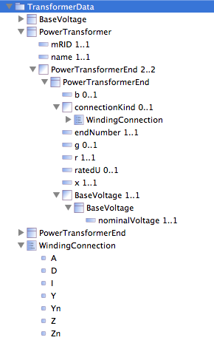
Deriving a Profile
A number of tools exist where the NDR can be applied and profiles built to define the messages
Using the data in the previous example we build the profile shown to the right
This is then used to create an XML Schema

Slide 242
XML Schema Representation

Slide 243
Instance Example
The Schema defines the structure of the data, the resulting XML instance data is shown opposite
The namespace is that of the profile, not the CIM
The structure is similar to that of the CIM RDF XML examples
The most noticeable difference is that the data is hierarchical in nature.

Slide 244
Tutorial Section XI ***** Implementation Techniques
Alan McMorran
Open Grid Systems
alan@opengridsystems.com

Slide 245
CIM Enabling Software
The CIM defines external interfaces
Making software CIM compatible does not mean its internal data structures have to be based on CIM
Supporting CIM means an application must be able to import and/or export CIM data and support the CIM RDF or XSD XML formats
A CIM adapter will map to and/or from an application’s internal data structures and CIM

Slide 246
Example: Supporting CIM Import
A common scenario is that a vendor wishes to be able to import electrical network models in CIM RDF XML to run analysis functions such as power-flow, state estimation etc.
The software has its own internal data structure to represent the network components e.g. buses, loads, generators, branches etc.
To support the import of CIM data the CIM data elements relevant to the electrical network model must be mapped to the internal structure

Slide 247
Bi-Directional Transformation
In some cases the requirement is only to import or export in which case the transformation is one-way
For many applications there is a need to import and export CIM and ensure that there is consistency between the import and export
The software must ensure that a native element is always mapped to the same CIM element and vice-versa.

Slide 248
Stateful vs Stateless Transformation
In a one-way transformation to import CIM data the process is relatively simple:
The Transformation converts CIM to the Internal Analysis Application structure and the application performs the analysis
The analysis application has no knowledge that the original source was CIM and operates as normal

Slide 249
Stateful Transformation
The process becomes more complex when the application must export data back to CIM (e.g. the results of the power-flow)
If a CIM Element was mapped to an Internal Element that now has results then the reverse Internal to CIM Transformation must ensure the results refer to the same CIM Element when transformed back

Slide 250
Stateful Transformation
There are two approaches to this problem:
Ensure the Internal data structure can refer to its corresponding CIM element (e.g. store the CIM mRID in the internal data structure)
Use an Identity Registry to track and share the mappings between CIM and Internal elements
The first solution is the least complex but is rarely practical when dealing with established, legacy formats and fixed database schemas

Slide 251
Identity Registry
Using an Identity Registry allows each Transformation to have access to the output of any previous transformations
This allows CIM and Internal elements to maintain consistent mappings across multiple import/export processes

Slide 252
Supporting CIM XML
A number of approaches are available to support import/export of CIM data:
Custom native code to read CIM XML and write to the internal format (fast but difficult to maintain)
XML Stylesheet Transforms (XSLT) are popular for transforming XML data and supported by common Enterprise platforms
Extract Transform Load (ETL) tools designed to map between file formats and database schemas
Model Driven Transformation languages

Slide 253
Model Driven Transformation
Model-Driven Transformation (MDT) defines the data mappings at the model (structural) level, independent of the source and target formats
For MDT an information model is required for the source and target data
In some cases an information model will already exist e.g. CIM, MultiSpeak or an internal Enterprise Semantic Model
Sometimes the information model is implicit to the format and can be derived automatically e.g. database schema or XSDs
Other times you need to reverse-engineer the information model from the format itself e.g. CSV files or column-oriented text formats

Slide 254
Transformation Definitions
Transformations are written against the models and there are a number of model-driven transformation languages
The same transformation can be used with data coming from web services, databases, files or any other data source as the transformation runs against format-agnostic data objects
Interfaces convert the source data to these data objects
Multiple interfaces can be used to get data in the same structure to/from different formats

Slide 255
Transformation Example: CIM to PSS/E
An example of this process is to convert CIM into PSS®E format
The PSS®E data structure must be derived to create a PSS®E information model
A serializer for PSS®E RAW files must be written to write the format-agnostic data objects into PSS®E RAW format
A transform between the CIM classes and the PSS®E information model elements
A CIM RDF XML parser must be written to convert the CIM RDF XML into CIM data objects

Slide 256
Creating the Information Model
Defining the PSS®E information model involves a reverse engineering of the format to determine the elements, attribute and associations
With PSS®E the process of defining the model is primarily a manual task based on the comments and meta-data within the instance files (and if available, any documentation)
With PSS®E there are a number of complex elements including: Bus, Branch, Transformer, Load, Generator and Shunt, as well as containment and ownership elements

Slide 257
Model Driven Transformation
An example of a transformation using the QVTO language to map CIM EnergyConsumer to a PSS®E Load is shown below

Slide 259
Benefits of Model Driven Transformation
An MDA approach when dealing with CIM data offers a number of benefits
By ensuring that all data has a defined structures with an information model it makes is easier for users to understand and identify how it maps to the CIM
Model Driven Transformation makes it easier to write and maintain the mapping of complex data structures between systems
By separating the parsing of the data from the transformation itself the process is modularized
The parsing module is re-usable in a number of processes and simplifying the transformations so they do not have to deal with the added complexity of file formats or database access.

Slide 260
Performance Trade-offs
The CIM is a complex and detailed model
When transforming data from system A to system B, when viewed in isolation, adding CIM into the middle would appear unnecessary
As the number of systems or data sources that be imported from or exported to increases having 1 to 1 mappings results in an exponential increase in the number of transforms that must be supported

Slide 261
Performance
Depending on the technology deployed adding a CIM transformation process can result in a drop in performance compared with a direct exchange
This has to be balanced with the reduction in development costs and time to support different formats and interfaces
A CIM Interface also provides a re-usable interface that can be used by multiple systems

Slide 262
Transforming to a Standard
The major benefit of supporting a standard is to enable the exchange of data with other systems
This removes the need to write n transformations for n other formats

Slide 263
Transforming to a Standard
As more vendors support CIM import/export there is a reduced need to support undocumented third-party proprietary formats
Regular interoperability tests ensure that vendors can successfully exchange models

Slide 264
Available Technologies
For application engineers seeking to implement a CIM interface it it can at first appear daunting
XML Parsers are available in most modern computer languages
For RDF libraries such as Jena under Java provide RDF parsers
However it can sometimes be simpler to just build a custom CIM RDF Parser using standard XML libraries

Slide 265
Java: Eclipse Modeling Framework
Under Java the Eclipse Modeling Framework (EMF) provides a Model-Driven software framework that can be used with CIM
A CIMTool plugin allows the export of artifacts that can be used to build CIM Java classes using EMF
Combining these Java classes with RDF import/export modules aids the creation of CIM interfaces

Slide 266
Java: Eclipse Modeling Framework
EMF can also be used to generate Java from XML Schema Definitions (XSD)
This provides an interface to read and write XML Instances that conform to the XSD
The data is dealt with as in-memory Objects and translation to/from source data can be written using normal APIs:
Breaker breaker = WiresFactory.eINSTANCE.createBreaker();
breaker.setName("My Breaker");
Terminal terminal = CoreFactory.eINSTANCE.createTerminal();
terminal.setName("My Terminal");
terminal.setConductingEquipment(breaker);
SvPowerFlow pf = StateVariablesFactory.eINSTANCE.createSvPowerFlow();
pf.setP(2.3f);
pf.setQ(0.9f);
pf.setTerminal(terminal);

Slide 267
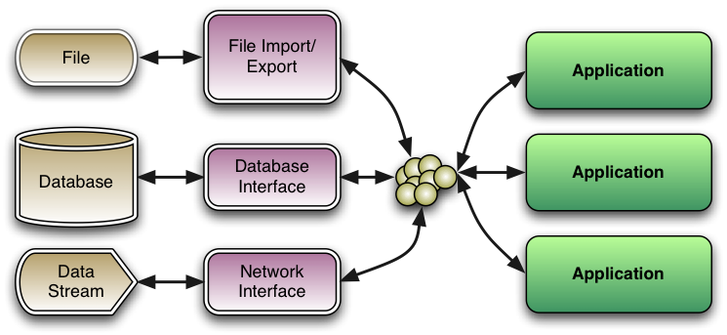
Java: Eclipse Modeling Framework
Applications are written to deal with the objects irrespective of where it is stored and in what format

Slide 268
Java: Eclipse Modeling Framework
The Java environment also provides a runtime for the QVTO language
A CIM meta-model can be automatically generated from CIMTool
The application meta-model can then be imported, built manually or derived
An executable transform is then defined between the models with the (de)serialization operating in a separate module
Standard libraries and connectors already exist to interface with many common databases

Slide 269
Model Driven
The benefits to this approach is that there is traceability from the code back to the original information model
Changes to the information model can be propagated back to the code itself
Reduces risk of human error (e.g. spelling mistakes!)
Engineers can then spend more of their time dealing with the mappings between structures rather than file formats

Slide 270
Tutorial Section XII ***** CIMTool
Margaret Goodrich
SISCO
margaret@sisconet.com

Slide 271
Introduction
The purpose of this presentation is to describe the use of CIMTool
Some of the uses of CIMTool include:
Definition of information exchange profiles
Development of RDF Schemas
Validation of CIM XML instance files
Validation of incremental CIM XML files

Slide 272
Contents
CIM Profiles
CIMTool Installation
Creating a CIMTool Project
Importing a Schema
Creating and Editing a Profile
Importing a Profile (Several Methods)
Generating RDF Schemas
Importing a Model
Validating a Model
Importing and Validating an Incremental Model
Updating a Schema
Miscellaneous

Slide 273
CIM Profiles
CIM PROFILES

Slide 274
What is a Contextual Profile?
The set of classes, attributes and relationships in a contextual profile (a.k.a. profile) is a subset of the classes, attributes and relationships found in a schema
The cardinality of a relationship in a profile is either the same or more restrictive than the relationship in the schema
A profile is often given a name (e.g. CPSM)
Each profile will have an assigned namespace
Profiles are also known as ‘contextual models’
Within CIMTool, profiles are managed using an OWL format, where a .owl extension is used
Important to note that OWL is based upon RDF
Profiles can be realized in a variety of forms, including but not limited to RDFS, XML Schema, HTML and Word Documents

Slide 275
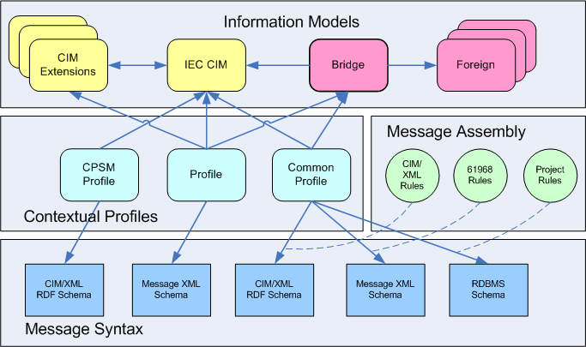
Information Models and Profiles

Slide 276
CIMTool Installation
CIMTool Installation

Slide 277

What is CIMTool?
CIMTool is an Eclipse plugin
It provides the means to:
Define profiles from a UML model
Import profiles from a spreadsheet
Validate profiles
Validate instance files against a profile
Validate incremental files against an instance file and a profile
Generate RDF schemas from a profile
… and more

Slide 278

Preparation for Installation
You should have a PC running a recent version of Windows, Linux or Mac OS, with at least 1GB memory
Recommend at least 2GB free disk space (much more is recommended if you will be working with large CIM network models)
You need an internet connection, noting that there may be 200MB of downloads required for installation
You need a Java runtime environment (JRE)
Java 5 JRE is currently recommended
If you don’t have one you can download from http://java.com

Slide 279
CIMTool Installation
Go to http://cimtool.org
Version 1.9.3 is currently available for download
Download a zip file with Eclipse and CIMTool (full installation package)
Following the directions on the screen

Slide 280


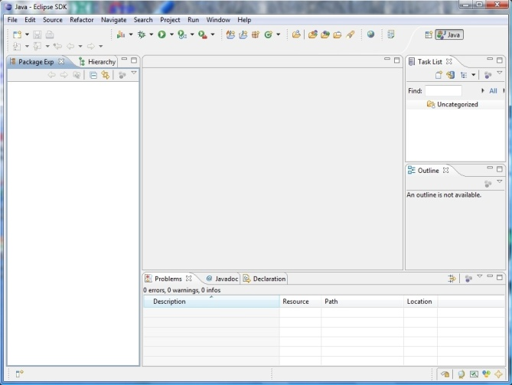
Starting CIMTool
Click on the Eclipse icon
The Eclipse startup dialog will appear
Define a ‘workspace’ directory when prompted
The workbench view will then appear

Slide 281
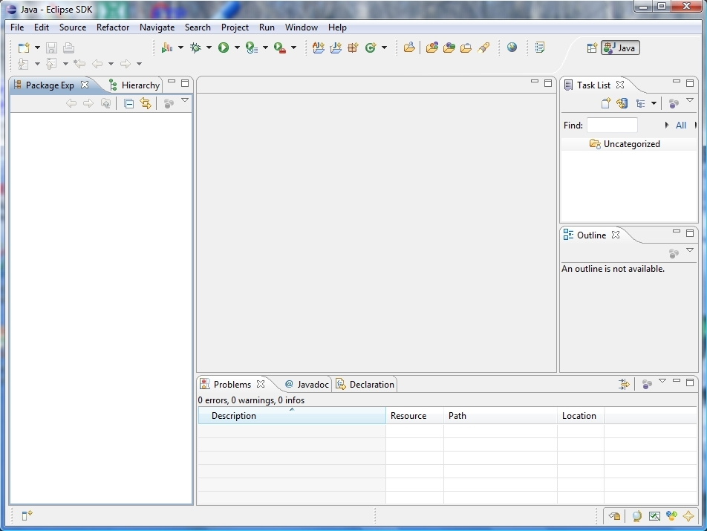
Eclipse/CIMTool Workbench
Initial default view before any projects are created
Default installation supports Java development

Slide 282
CIMTool/Eclipse Hints and Tips
Files, Packages and Workspaces:
It is important that you never add, modify or delete anything inside a workspace directory with tools other than Eclipse
If there is ever a ‘resource out of sync’ problem, you can usually correct by using the ‘refresh’ option
You may however safely read files directly from the workspace folder if needed

Slide 283
Creating a CIMTool Project
Creating a CIMTool Project

Slide 284
CIMTool Projects
Each project has a named folder in the workspace directory
Each CIMTool project will have four sub-folders:
Incremental: for CIM XML incremental files in RDF format with a .xml extension
Instances: for CIM XML instance files in RDF format with a .xml extension
Profiles: for profile definitions, where
Profile definitions are stored in an OWL & RDFS formats
Log files, which may identify errors, are text files with a .log extension
Depending upon the usage of CIMTool, there may also be HTML, RDFS and XSD files
Schema: for the CIM model in XMI format with a .xmi extension (Generated using the UML model from the EA Tool)
Folders and files that have errors may include a red X on their associated icon

Slide 285
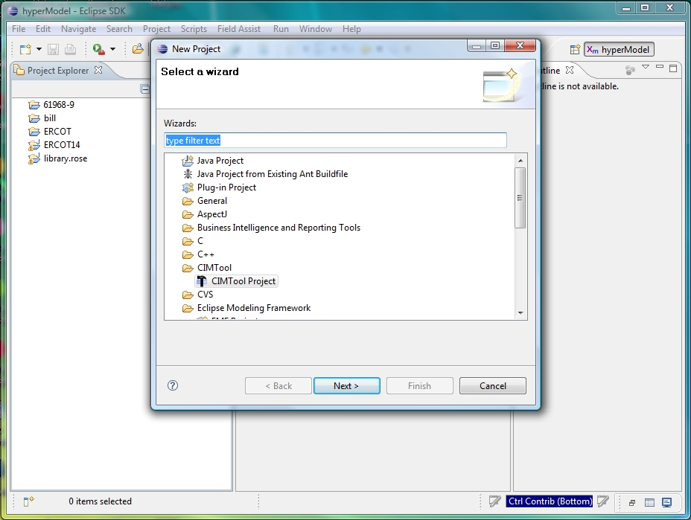
Creating a New CIMTool Project
Select ‘File > New > Project’
Select ‘CIMTool Project’ option
Click ‘Next’

Slide 286
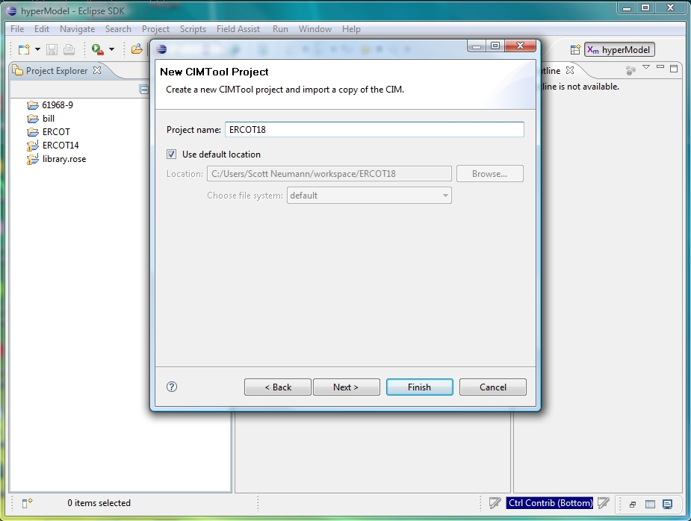
Creating a New CIMTool Project
Name it – e.g. ‘IIE18’
Click ‘Finish’
This will create a new folder in your workspace directory

Slide 287
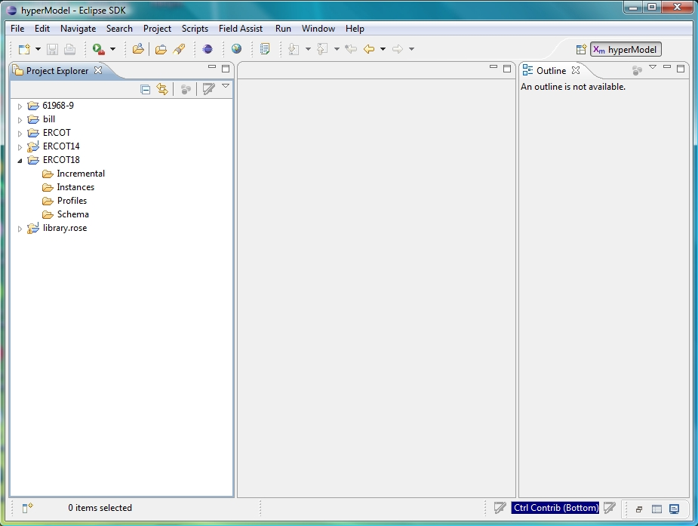
Browsing the Project
Click on arrow to tClick on arrow to the left of the desired project name in the Project Explorer to expand it
See that project has the 4 set of folders
Expand sub-folders to see

Slide 288
Importing a Schema
Importing a Schema

Slide 289
Importing a Schema
Schemas describe the classes, attributes and relationships defined by a UML model
Anything defined by a profile MUST be described within the UML model
Schemas must be in a suitable XMI format for import
The XMI files are typically generated from the CIM UML model created/maintained using Enterprise Architect
Schemas will be stored in the ‘Schema’ folder of the project
There is typically one schema for a project, although there are cases where there may be more than one

Slide 290
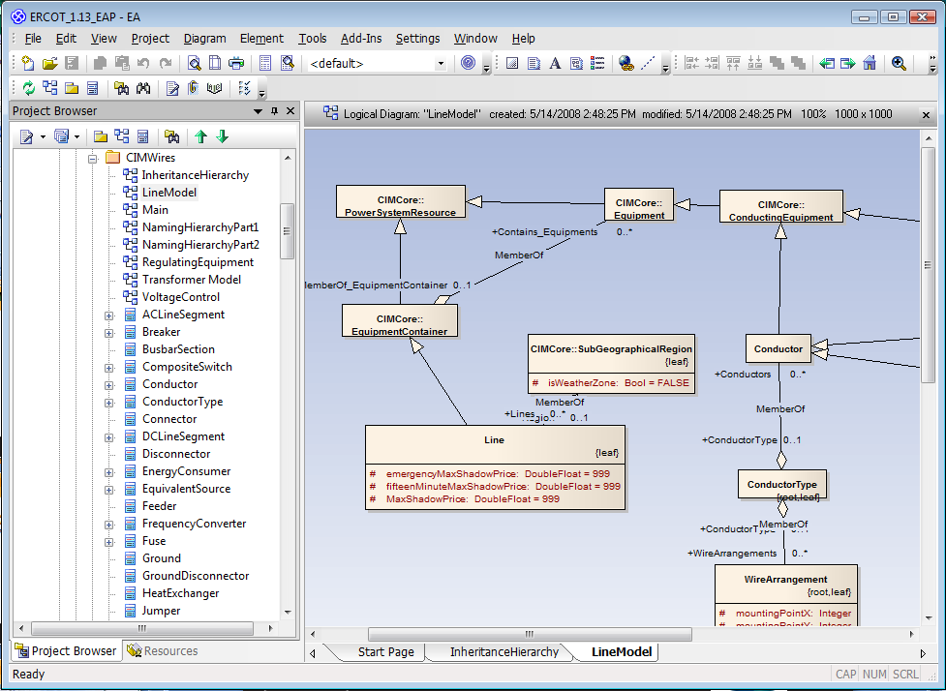
Schema in a UML Tool

Slide 291
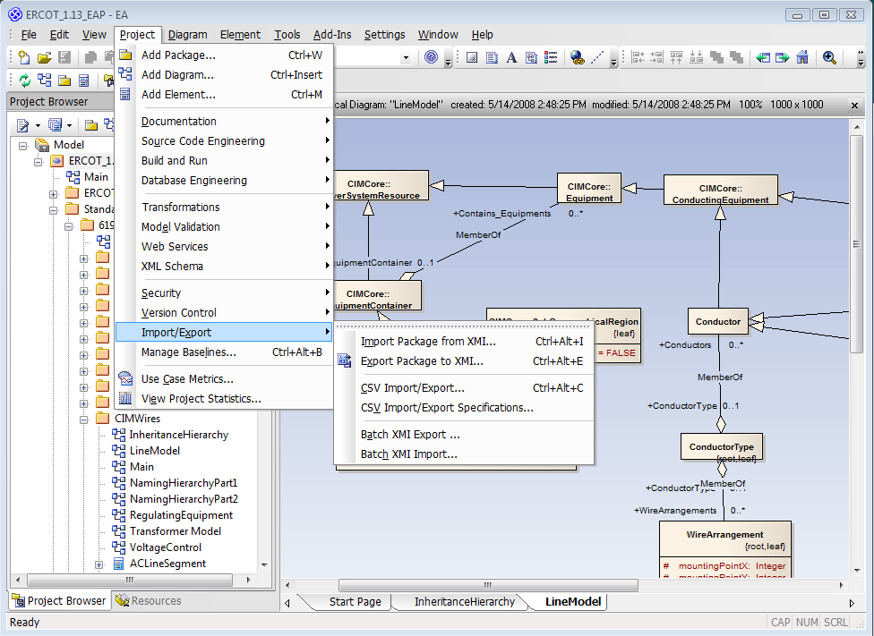
Exporting UML Model as XMI
In Enterprise Architect select the top-level package
Select Project > Import/Export > Export Package to XMI

Slide 292
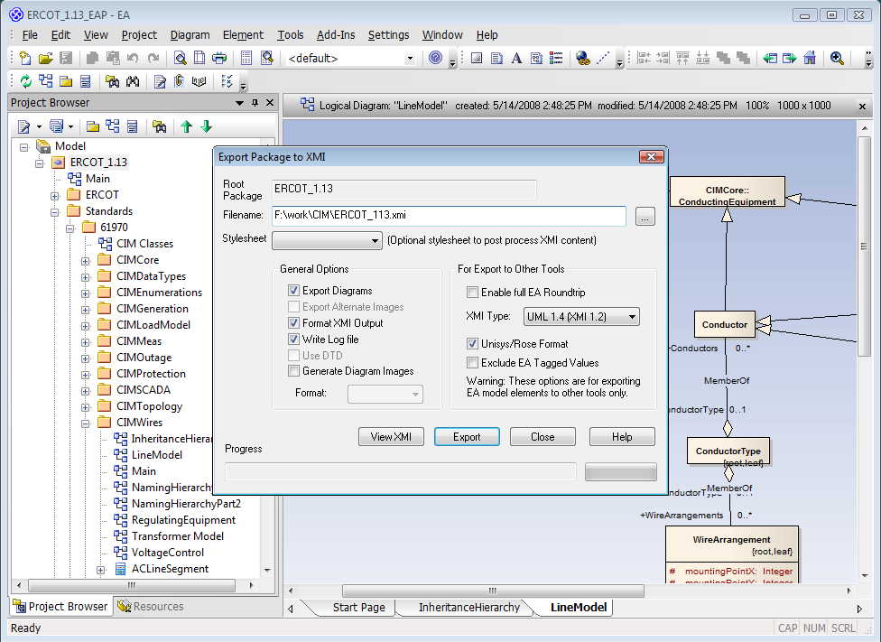
Exporting XMI from UML Tool
Use export options shown
Export as UML 1.4
Unselect ‘Enable full EA Roundtrip’
Select ‘Unisys/Rose format’ option
Enter file name for XMI file
Click on Export button

Slide 293
Schema Import within CIMTool
Schemas are imported when creating a new CIMTool project
Schemas can also be added to supplement an existing schema
Schemas can also replace an existing schema, as in the case of a new CIM version

Slide 294
Initial Schema Import
Select ‘File > Import’
Note the different import options under CIMTool
Select ‘Import Schema’ option
Click ‘Next’

Slide 295
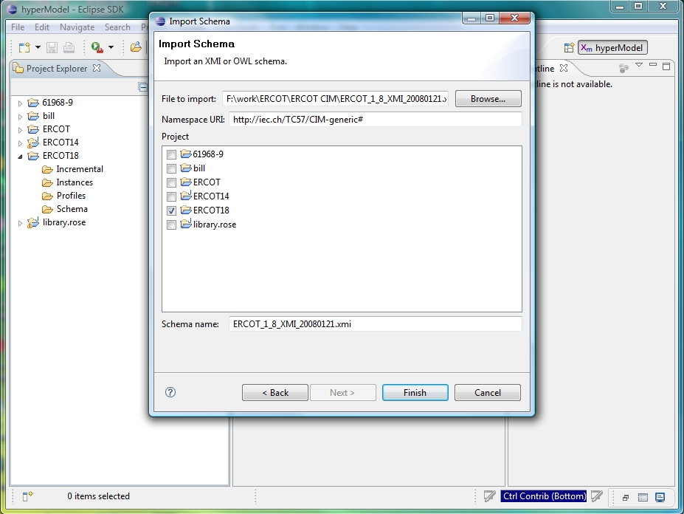
Initial Schema Import
Browse to find the XMI file to import
Check the project for the import
Don’t edit the Namespace
Click “Finish”

Slide 296
Creating and Editing a Profile
Creating and Editing a Profile

Slide 297
Creating a New Profile
There are four ways to create a new profile:
Create it from scratch within CIMTool
Import an OWL profile previously constructed using CIMTool
Import the profile from a data dictionary spreadsheet
Copy and paste an existing profile within CIMTool
Once created, profiles are stored in the ‘Profiles’ folder of the project
A project may have many profiles
Each profile will have a namespace
This following slides describe the creation of a new profile using the edit capabilities within CIMTool

Slide 298
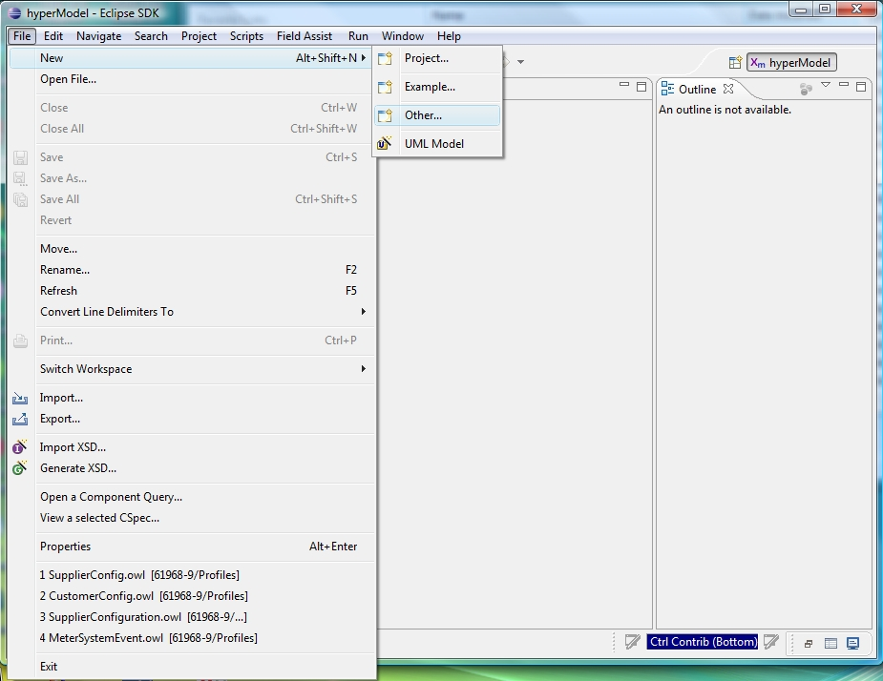
Creating a New Profile
Select ‘File > New > Other …’

Slide 299
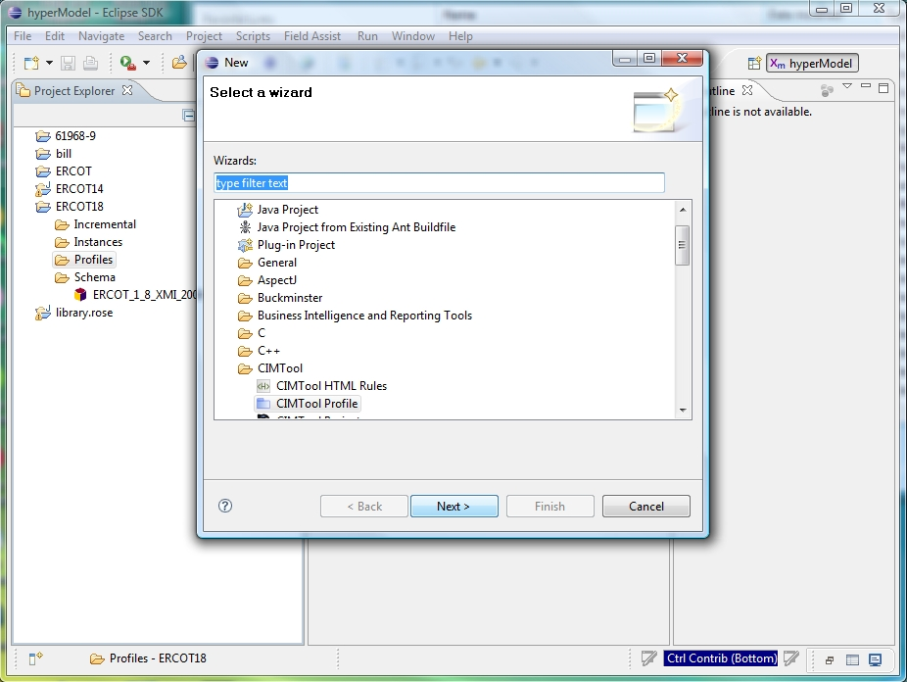
Creating a New Profile
Select ‘CIMTool Profile’ option
Click ‘Next’

Slide 300
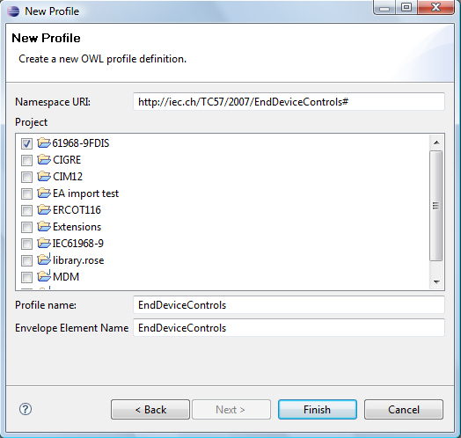
Creating a New Profile
Click on checkbox for the desired project
Determine a unique name for the profile that will not conflict with other profile names, then using the name:
Set the profile name
Set namespace URI
Set envelope element name
Click ‘Finish’

Slide 301

Browsing the Project
Click on arrows in Project Explorer to expand folders
Double click on the .owl profile file name in the to open it
Click on the profile name in the Outline window
In the Project Explorer frame you can always right click on a file name to see options

Slide 302

Adding Classes to Profile
Browse through model on the right side of Add/Remove tab
Select one or more classes on right side Add/remove tab
Classes are moved by clicking on <

Slide 303

Adding a Property to Profile
Click on a class in the Outline
Properties are shown on the right side of the Profile Add/Remove tab
Click on property name on right side
Click on ‘<‘ to move property to left side

Slide 304

View After Adding a Property to profile
New profile property is seen on Outline view and the left side of the Add/Remove tab
You can remove properties by using the > button

Slide 305

Adding Properties to Profile
Can move more than one property at a time

Slide 306
Importing a Profile
Importing A Profile

Slide 307
Importing a Profile
Sometimes it is desirable to use another profile definition as a starting point for a profile definition
CIMTool saves profile definitions in an OWL format
Profile definitions from another project or workspace can be imported to create new profiles

Slide 308

Importing Profiles into CIMTool
Select ‘File > Import’
Note the different import options under CIMTool
On ‘Import’ dialog select ‘CIMTool – Import Profile’ option
Check the project to import into
Browse to find the file to import
Click ‘Next’

Slide 309
Importing Profile from Data Dictionary
Importing a Profile from Data Dictionary

Slide 310
Importing Profiles
Some products can generate a Data Dictionary in the form of an Excel spreadsheet
The spreadsheet can define one or more profiles
Note that the spreadsheet can be maintained independently of any particular product
The Data Dictionary defines the classes, attributes and relationships that comprise one or more profiles
This can be imported into CIMTool to define a profile

Slide 311

Data Dictionary
An Excel spreadsheet that describes the contents of one or more profiles
Tabs exist for Classes, Attributes, Associations, Data types, Enumerations and Units

Slide 312

Importing Spreadsheet
Can import the Data Dictionary spreadsheet as a profile
File>Import
Select ‘Import Spreadsheet as Profile’ option

Slide 313

Importing Spreadsheet
The spreadsheet may identify one or more profiles
Can select which profiles to construct
Can only construct one at a time

Slide 314

Importing Spreadsheet
Need to identify the project in which the profile will be created
The name of the profile is set by default, but can be modified

Slide 315

Importing Spreadsheet
New profile (.owl file) is created if there are no fatal errors
A log file is created that identifies any errors

Slide 316

Importing Spreadsheet
A log file (.log) is generated with the profile to identify errors, if any
The log file identifies what could not be found for inclusion into the profile definition

Slide 317
Extending the Spreadsheet
You can also create a new profile definition in the spreadsheet for import into CIMTool using the following steps:
Insert new profile columns into the ‘Classes’, ‘Attributes’ and ‘Associations’ tabs
Provide the same profile name on row one of each of the added columns
Set the value of each new cell to ‘TRUE’ or ‘FALSE’
Run the spreadsheet import process as described previously
Look for errors in the log file

Slide 318
Creating a Profile using the Copy/Paste Function
Creating a Profile Using the Copy/Paste Function

Slide 319
Create a Profile Using Copy/Paste
319
Select the Profile you wish to copy
Right click on the .Owl file and select ‘Copy’
Right click again and select ‘Paste’
Enter the name of the new Profile to be created in the Dialog
The set of Profile files will be generated
Right click on the new .Owl file and select Properties
Enter the new Profile namespace in the dialog
This method will be demonstrated after the presentation
Notes:
319

Slide 320
Generating RDF Schemas
Generating RDF Schemas

Slide 321

Generating RDF Schemas
Load the desired profile
Select the ‘Summary’ tab

Slide 322

Generating RDF Schemas
Check ‘Builder for legacy-rdfs’
Check any other desired builder options
Click on ‘File>Save’

Slide 323

Generated RDF Schema
To view the actual RDFS, right click file name in Project Explorer
Then select ‘Open With > Text Editor’ option

Slide 324
CIMTool Output Options
CIMTool can generate several ‘styles’ of RDF or OWL as outputs for profile definitions, including:
Legacy RDFS (currently the most commonly used)
Legacy nested RDFS
Simple OWL
Simple nested OWL
Examples of each style will be displayed upon request
CIMTool can also generate XML Schemas and HTML as outputs
Both the form of XSDs and HTML generated can be controlled by stylesheets

Slide 325

HTML Documentation
HTML option generates a single HTML file with description of all classes
Hyperlinks allow navigation between class descriptions and type definitions

Slide 326
Importing a Model
Importing a Model

Slide 327
Importing a Model
In order to validate a model, it must first be imported
Model files to be imported are in a CIM/XML RDF format with a .xml extension
Model files can be very large, as much as 2GB in size
The import process can take many minutes
The resulting model is placed in the ‘Instances’ folder of the project

Slide 328

Importing a Model
Select ‘File > Import’
On ‘Import’ dialog select ‘Import Model (CIM/XML file)’ option
Click ‘Next’
Check the project to import into
Browse to find the file to import
Select an appropriate profile
Click ‘Next’
OR
Select the Model Import ICON on the toolbar and complete the screen shown

Slide 329

Importing a Model That Already Exists
Change the file name if you wish to save to a different sub folder
Check ‘Replace existing model’ if you wish to overwrite
Click ‘Finish’
Wait for the import to complete, as it may take several minutes (up to an hour for a very large model)
Watch the progress icon at the bottom of CIMTool where it says ‘Importing model …’

Slide 330
Imported Model
The imported RDF model is stored within the Instances folder of the project
Errors are recorded in log files
A folder is created to store the model in typically many smaller files that have a .ttl extension
The .ttl files are in Terse RDF Triple Language format (more compact than CIM XML)

Slide 331
Validating a Model
Validating A Model

Slide 332
Validating a Model
Validation of the model occurs when a model is imported
Errors are identified in log files in the ‘Instances’ folder of the project with a name in the form <profile>.log
If errors exist, a diagnostic file is created which can be browsed
CIMTool has a default set of validation rules, where the rule file is named <profile>.split-rules
Rules can be edited and extended

Slide 333
Example Validation Errors
Undefined classes
Undefined properties
Instantiation of abstract classes
Illegal cardinality on an association (e.g. more or less associations than expected)
Range violation for a data item
Illegal domain of a property
Base voltages for conducting equipment connected at a connectivity node do not agree
Isolated nodes
Untyped objects
Missing or extra terminal
Duplicate properties
Unexpected loop

Slide 334

Browsing Diagnostic File

Slide 335
Importing and Validating an Incremental Model
Importing and Validating an Incremental model

Slide 336

Importing Incremental CIM/XML
First step is to import an incremental CIM/XML file using File > Import and select CIMTool/Import Incremental CIM/XML file (or use the ToolBar ICON)

Slide 337

Importing Incremental CIM/XML
Must have imported a base instance model BEFORE attempting this
Need to browse to select file
Need to select the appropriate base model
Errors will be reported in a log file

Slide 338
Validating an Incremental Model
Validation occurs when the model is imported
Errors are identified in log files in the ‘Incremental’ folder of the project with a name in the form <profile>.log
If errors exist, a diagnostic file is created which can be browsed

Slide 339

Browsing Diagnostic File

Slide 340
Updating a Schema
Updating A Schema

Slide 341
Updating a Schema in CIMTool
From time to time, there may be updates to the UML model. These updates will result in a revised XMI file
You should not directly replace a file in the CIMTool workspace directory
You should instead, using CIMTool File menu options:
Delete the old schema
Import the new schema
Be sure that the correct namespace is entered
Profiles with errors will be flagged with a red X

Slide 342
Namespaces
A commonly used namespace is http://iec.ch/TC57/CIM-generic#
If namespaces do not match between schema, profiles and the model files errors may be encountered
Default namespaces to be used by CIMTool can be changed using Window > Preferences and selecting CIMTool option
Most problems encountered in CIMTool surround the namespace.
It is best to use the default (defined above) for all project files

Slide 343

Changing Namespaces
Namespaces can be changed by right clicking on a file name in the Project Explorer and then selecting ‘properties’
The namespace is shown on the CIMTool property dialog
Namespaces can be changed as desired
Note that this may impact existing profile definitions

Slide 344
Miscellaneous
Miscellanous

Slide 345

Exporting a Project
It is often necessary to export a project for use by others, or to use on other computers
Use File > Export
Select Archive File option
Select Next

Slide 346

Exporting a Project
Need to select output format, ZIP is usually best
Need to select output file name
Project can be later imported back into Eclipse using File > Import

Slide 347

Switching Workspaces
Sometimes it is necessary to move or change the location of your workspace folder, or use multiple workspaces
To point Eclipse to the new workspace folder use File > Switch Workspace
Select the desired workspace folder
The settings will be updated and Eclipse will restart

Slide 348
Renaming Resources
Sometimes it is necessary to rename projects, folders within a project or files within a folder
It is important to do this using Eclipse, instead of directly making changes to the resource outside of Eclipse
To rename, right click on the desired resource in the Project Explorer and select ‘Rename’
Now you can change the name of the resource

Slide 349

Changing CIMTool Preferences
Preferences can be changed using Window > Preferences and selecting CIMTool option
Select ‘Apply’ and ‘OK’ after editing to save

Slide 350

Diagnostics
Errors will be written to ‘.diagnostic’ files
These are often the consequence of changes in the CIM that have eliminated used classes, relationships or attributes
Profiles can then be edited to correct the problems

Slide 351
Backing Up a Project
Easy way …
Easiest way to back up a project directory is to use WinZip or a similar archive tool
Using WinZip (or similar tool), simply create an archive file of the project folder within the workspace
Using a source repository …
Many commercial source repositories options exist that integrate with Eclipse
Plugins can be found for:
CVS
Visual Source Safe
Clear Case

Slide 352

Importing a Project
Select File > Import > To import projects into Workspace
Click Next
Browse to identify a project directory
Can use ‘Copy projects into workspace’ to make a copy of the directory instead of working directly out of the chosen directory

Slide 353

Deleting a Project
Right click on name of project in the Project Explorer
Files will only be deleted if the ‘Also delete contents under …’ option is selected
Click ‘Yes’

Slide 354

CIMTool Updates
TO obtain updates to Eclipse and CIMTool
Use Help > Software Updates > CIMTool
Select ‘Search for New Features to Install’ option

Slide 355
Where Do I Get …
CIMTool and Eclipse:
http://eclipse.org
http://cimtool.org
CIM:
http://www.ucaiug.org/CIMug
IEC Standards:
http://www.iec.ch

Slide 356
Acknowledgements
Not possible without the efforts of Arnold DeVos, the developer of CIMTool
Thanks to those companies that also helped to fund CIMTool development
Thanks to the CIM model managers that have helped to advance the CIM:
Kurt Hunter, Siemens (WG13)
Kendall Demaree, Areva (WG13)
Lars-Ola Osterlund, ABB (WG13)
Tatjana Kostic, ABB (WG14)
Margaret Goodrich, SISCO (WG16)

Slide 357

More Information
Eclipse web site: http://eclipse.org
CIMTool web site: http://cimtool.org
E-mail: margaret@sisconet.com
Screen Shots Compliments of UISOL and Scott Neumann

Slide 358
Tutorial Section XIII ***** Interoperability & IOP Testing
Margaret Goodrich
SISCO
margaret@sisconet.com

Slide 359
Topics
Major IOP Artifacts
Major Activities
IOP Profile Contents (both Model and Message)
Models and Message Exchange
Role of Test Witness
Report Test Contents
Next Steps

Slide 360
Major IOP Artifacts
Use Cases and Test Cases (ENTSO-E and Vendors)
Profile Document(s) (ENTSO-E and Vendors)
Test Exchange Models (Vendors)
Test Procedure (ENTSO-E)
Test Report (ENTSO-E)

Slide 361
Major Activities
Conference Calls with Vendors and Test Witnesses
Update of the UML Model, if needed
Revision of the IOP Profile
Generation of the Test Procedures
Pre-Test – Exchange of Model Files
Execution of the Test and Capture of the Data and Results
Generation of the Test Report

Slide 362
Profile Contents
A Profile is the portion of the UML that is included in the IOP to complete the Use Case.
The Profile defines the set of data (classes, attributes and associations) that MAY be exchanged.
A Model Exchange Profile (i.e., the CPSM profile for example) defines a subset of the CIM that will be exchanged and defines the minimum requirements as a Power System Model that is complete enough to allow a Power Flow to be solved.
The Model Exchange Profile will be represented in an RDF Schema and will use CIM/XML RDF files to complete the exchange.

Slide 363
Profile Contents
A Message profile defines the set of data that must be provided to complete a specific task.
The Message profile actually defines a superset of the contents that will be exchanged.
Message profiles use XML Schema and the XSDs are then used to generate the XML message(s) that will be exchanged for each task.
One of more full models may be used for exchange of a Power System Model for Transmission or Distribution.
One or more Profile Group files may also be provided for use in the Transmission or Distribution model exchange.
One or more Message profiles (XSDs) may be provided for use in the Distribution and Market exchange.

Slide 364
Models and Message Exchange

Slide 365
Exchange Test Cases
Define the type of tests to perform
Full Model Exchange
Profile Data Group Exchange
Message Exchange
Define the contents of the tests
Exchange EMS data between two or more EMS Systems
Exchange data between two different systems – e.g., GIS data flowing to a DMS system
Exchange messages between two systems – e.g., metering data sent to an MDM system

Slide 366
Model Exchange Test Cases
61970-452 – CPSM exchange - Model Exchange focus
61970-456 – Planning & Dynamics exchange – Solved Case focus
62325-452 – Market exchange – Model Exchange focus

Slide 367
Model Exchange Test Cases
Exchange of CPSM & Market Models

Slide 368
Message Exchange Test Cases
Market – Message Exchange focus will use XSD XML Messages provided by the vendors: ABB, Siemens, EDF, Areva, Software AG, Item Solutions, Delta Energy Solution AG, Transition Technologies, Smart Technologies, Unicorn, Astron KFT, Soptim AG, Innsoft, PSI, etc.
These messages still need to be fully defined and agreed to between the Utilities, the ISOs and the Vendors.

Slide 369
Message Exchange Tests
Application B
Documents
Web Service
Message Bus
Web Service
Web Service
Application A

Slide 370
Role of Test Witness
Prior to the Test:
Obtain model information for each model to be exchanged
Review Test Plan & Procedure document
Install and learn to use the CIM Validation Tools
Participate in the conference calls and provide expertise
Review the Profile
During the Test:
Observe and ensure that the test Participant executes the test as defined in the Test Procedure
Observe the results and complete any analysis necessary to determine the status of the results

Slide 371
Role of Test Witness
During the Test, Continued:
Record the test results
Record any and all issues
After the Test:
Review the Test Report and ensure that all results and issues are correctly recorded
Participate in the conference calls to discuss the issues and provide required feedback

Slide 372
Test Report Contents
Objectives & Scope of the Test
Test Participants
Test Results with Tables showing results recorded from Test Record Forms
Summary of Issues
Appendix with Marketing Material for Participant Products
Appendix with Test Configuration Data
Appendix with Test Approach and Descriptions (form Test Plan)

Slide 373
Next Steps
Submit IOP findings, report and issues to IEC WGs for review and consideration

Slide 374
Tutorial Section XIVa ***** Enterprise Integration: Models and Applications
Margaret Goodrich Scott Neumann
SISCO UISOL
margaret@sisconet.com sneumann@uisol.com

Slide 375
Introduction
The purpose of this presentation is to describe a process for using the CIM for enterprise integration
This process is reflective of IEC standards efforts, best practices and integration experiences at major utilities including AEP and BC Hydro
This is an attempt to provide an overview of key topics given time constraints

Slide 376
What are we integrating?
Above is a common example for distribution
Other examples are transmission or market systems
Can not assume one size fits all

Slide 377
People and Process
Integration success involves people and process as much as technology
It is necessary to have people from different ‘silos’ work, recognizing that not everyone has the same knowledge, responsibility, focus or skill set
The architecture and processes need to be well documented, where opportunities for training and discussion are provided to be supportive of ‘buy in’
A strong governance process is needed to insure architecture conformance, but…
Processes are also needed to address cases where exceptions are needed
Time and budget are factors that must be recognized, and may factor into specific integration priorities and decisions

Slide 378
Documentation
Documentation is key for design, governance, development, testing, deployment and support… avoiding dependencies upon ‘tribal’ knowledge
Documentation must be useful and provide value to a given audience, using a set of standard templates and avoiding replication of information
Use of industry standards helps avoid reinventing wheels
The architecture should be documented in a manner that provides guidance all those doing modeling, design and development
Things that need to be documented to support integration include:
Use Cases
Functional requirements
Non-functional requirements
System Interaction Specification
Interface designs for source and target(s)
Models and mappings
Integration patterns
In general, if something isn’t documented, take the view that it doesn’t exist!

Slide 379
Uses Cases
Everything needs to start with use cases… as they help define requirements and are supportive of testing
In the simplest terms, a use case answers the question: ‘WHO does WHAT to WHO, WHEN, and WHY do they do it?’
The ‘WHO’ are called actors, which may be persons with specific roles or systems
A sequence diagram should be defined to describe the information flows between actors, describing the WHAT and the WHEN
Each WHAT is typically viewed as a potential message
The WHY should be provided as background information
The use case does NOT say HOW!
Uses cases can be first defined at a business level, which then can guide the development of more detailed technical use cases as needed for implementation

Slide 380

Modeling Levels

Slide 381

Conceptual Models
Very important that it can be readily understood by business stakeholders
Provides the needed vocabulary for business-level use cases
Can be readily mapped to a logical model where a more detailed technical view is provided

Slide 382
Logical Models
The IEC CIM is the primary logical model of interest for this audience
However, there are other logical models that may be leveraged for integration purposes, especially when we get outside of the core electrical domain
Logical models are usually, but not always expressed as UML (e.g. OAGIS defined using XSDs)
Sometimes logical models are derived from legacy XML schemas, entity-relationship models, etc.

Slide 383

Logical Models
CIM fragment with classes, inheritance, associations, attributes and data types

Slide 384
Canonicals
Canonical data models are used for information exchanges to provide a common reference
Components convert to and from the canonical data model as needed to facilitate a given information exchange
Using the CIM, canonicals are defined using ‘contextual profiles’, where a subset of the CIM (and potentially other logical models) are leveraged
Each element of a profile/canonical can be traced back to a source element in a logical model
A canonical data model is a physical data model that is often realized as an XSD

Slide 385

Example Modeling Process

Slide 386
Tools
Process needs to be supported by tools
Need to avoid any ‘unique’ modeling approaches that could potentially result in rework, lock-in or inability to leverage tools of choice
Should understand the consequences of the use of any tool or any forced migration to another tool
Must avoid models being a ‘dead end’, where they are only useful as a reference instead of being used for the generation of useful design artifacts
Enterprise Architect (EA) for UML Modeling
CIMTool for Profile Generation – several others exist that will do the job too and most of them are free

Slide 387
Namespaces
Namespaces are used in models, XSDs, profile definitions and WSDLs
Changing namespaces can force significant levels of reimplementation effort… that might otherwise be avoided
Along the lines of OASIS recommendations, avoid changing namespaces unless there is an absolute need to do so to reflect a version that would otherwise be incompatible
Use the ‘version’ attribute to track version numbers, e.g.: version="1.0.0"
Each profile should/will have its own namespace, avoiding conflicts where a CIM class might be used differently in different profiles, e.g.: targetNamespace="http://iec.ch/TC57/2011/EndDeviceControls#"

Slide 388
Traceability
Need to be able to trace from a canonical/physical model back to a logical model
SAWSDL is a standard for semantic annotations
It is used to provide traceability within a contextual profile
This helps to avoid any semantic confusion
XML Schema fragment using SAWSDL:
<xs:complexType name="Asset" sawsdl:modelReference="http://iec.ch/TC57/CIM-generic#Asset">
<xs:sequence>
<xs:element name="mRID" minOccurs="1" maxOccurs="1" type="xs:string"
sawsdl:modelReference="http://iec.ch/TC57/CIM-generic#IdentifiedObject.mRID"/>
<xs:element name="category" minOccurs="1" maxOccurs="1" type="xs:string" sawsdl:modelReference="http://iec.ch/TC57/CIM-generic#Asset.category"/>
<xs:element name="name" minOccurs="0" maxOccurs="1" type="xs:string"
sawsdl:modelReference="http://iec.ch/TC57/CIM-generic#IdentifiedObject.name"/>

Slide 389
Integration Choices
Depending upon the integration scenario, there are many factors that may drive the implementation of an information flow
Some of the implementation options include:
Messages through an ESB that convey transactions to create, change or delete of objects
Event notification messages through an ESB that indicate the create, change or delete of objects
Messages through an ESB that support query requests, potentially with asynchronous replies
Web service requests for queries or transactions
Data set exchanges via CIM/XML files
Data set updates using incremental CIM/XML
Information transfer to a data warehouse using ETL mechanisms
HTTP requests
There are a variety of technical, performance, availability and security considerations that would need to be factored/addressed for any integration choice

Slide 390




Basic Integration Patterns
Synchronous Request/Reply
Point-to-Point
Asynchronous Request/Reply
Multicasting

Slide 391
Patterns and Verbs
Queries are indicated by the use of a ‘get’ verb on the request in a request/reply pattern, where the payload of the response message should return the requested information
Transactions are indicated by the use of verbs such as ‘create’, ‘change’, ‘close’, ‘cancel’, ‘delete’, and could use request/reply or point-to-point patterns
Both queries and transactions may result in responses (verb=‘reply’), which may indicate success or errors
Events are indications that something has happened of potential interest, using past tense verbs such as ‘created’, ‘changed’, ‘closed’, ‘canceled’, ‘deleted’ and typically use a multicast pattern

Slide 392
Transports
CIM is, by definition, transport independent, but the reality is that a wide range of messaging technologies have largely given way to JMS and HTTP
JMS provides a powerful messaging API, where the worst thing about JMS is the name, as it is not limited to use by Java applications
HTTP and JMS have some trade-offs:
JMS provides a reliable transport with the capability to queue and multicast messages
HTTP provides a standard ‘on the wire’ protocol, but JMS does not
SOAP may be layered on both of these transports, where the IEC 61968 message envelope may be placed within the SOAP body
When SOAP is used, it can be possible to define a WSDL that also provides a description of the interface
Other transports can also be considered, such as AMQP and REST
ESBs support the use of intermediaries

Slide 393
Web Services
CIM messages can be ‘wrapped’ by a WSDL
Two basic approaches: Loose coupled (coarse grained) or tightly coupled (strongly typed, fine grained)
For broadest compatibility, WSDL should be WS-I compliant and use document-wrapped style
Remember that HTTP is not the only transport possible… as JMS can be used to provide delivery guarantees, multicasting and other features not possible with HTTP
The use of a SOAP envelope enables the use of many security tools
WSDLs are sometimes less important than one might think, especially given the emergence of REST

Slide 394
Names
Object naming is an important aspect of integration that is often overlooked especially where all systems do not use common mRIDs
Issues:
The same object may be known in different system by different names
Messages need to use an identified that is known by source and targets
Some systems may need to be aware of multiple identifiers for a single object (e.g. local ID and external ID)
Sources and targets MUST agree upon names to be used, or rely upon the use of bilateral mapping tables for object names
A naming service could be used for allocating and managing names
The performance implications of name lookups needs to be carefully considered
Name class introduced in CIM v15 to help address these issues, providing a more realistic and useful model of object naming
In theory, an mRID is just another type of name!

Slide 395
Common Services
Common services are often implemented within an integration infrastructure to provide common functionality that is supportive of integration
Common examples include:
Logging and Exceptions
Claim Check
Notifications
Identity Management
Large message handling

Slide 396

Claim Check Pattern
Commonly used for exchange of large files, such as those containing CIM/XML
Functionality may wrapped within a service

Slide 397
Security
Key terms: Authentication, Authorization, Confidentiality, Integrity, Non-Repudiation, Denial of Service, Trust, …
If properly planned and designed, the implementation of security can be a last step (depending upon the implementation approach)
Different security policies will be needed in different situations, such as in the cases of intra-enterprise, inter-enterprise or extra-enterprise integration or where data has sensitivity and/or confidentiality requirements
Tools like TIBCO Policy Manager (as an example) make it very simple to implement necessary security policies using agents, where developers need otherwise not be concerned with security policy
If you are going to use SSL/TLS, how do you create and manage your certificates?
Does the integration impact critical infrastructure (e.g. as per NERC)?
One size does not fit all integrations

Slide 398
Error Handling
Error handling is dependent upon the integration pattern
In a request/reply pattern, the server can simply detect and report an exception back to the client
In a publish/subscribe or point-to-point pattern a means to log and report exceptions is needed
A notification infrastructure may also be needed to report errors to support staff

Slide 399
Integration Beyond the ESB

Slide 400
Tutorial Section XIVb ***** Enterprise Integration: ESB & SOA
Alan McMorran
Open Grid Systems
alan@opengridsystems.com

Slide 401
Tightly Coupled Services
The traditionally approach to system integration was to use tightly coupled systems
Systems would request specific services or data from another system with the interface tied to the target system
Changing systems required all existing, dependent systems to be updated to support the new system

Slide 402
Enterprise Service Bus
Enterprise Application Integration (EAI) replaces these dedicated links with a single communication link called a message bus
Middleware services provide a mechanism for applications to communicate using a pre-defined message format and requires only a single interface to be written for each application

Slide 403
Message Subscription
With an ESB a system can publish a message that is then consumed by multiple systems also connected to the bus
The sender does not know in advance which other systems will be using the data they publish (although obviously security and access restrictions can be implemented)
New systems can therefore plug into the bus and use existing data without requiring other systems to be modified to support it

Slide 404
Service Oriented Architecture
A Service Oriented Architecture (SOA) can utilize a ESB and separates the services from the systems providing them
Systems publish the services they have available and conversely request providers of the services they need
Systems are then loosely coupled, with a source system requesting a service without explicit knowledge of which other system on the Bus fulfills the request
Multiple systems may provide the same service and so an arbitration system will choose which system will fulfill the request

Slide 405
Enabling SOA
A key enabler for SOA and ESB is a common language and interface format for the data
Without a common data structure then it would be impossible for systems to be loosely coupled as they would require explicit knowledge of the target system’s interface
CIM provides that common language allowing services to be developed with a common, standard structure for the inputs and outputs

Slide 406
Tutorial Section XV ***** CIM in Smart Grid
Jay Britton
Britton Consulting LLC
jay.britton@comcast.net

Slide 407

Systems Era: 1970 ~ 1995

Slide 408

Enterprise Era: 1995 …

Slide 409
Enterprise Integration & Smart Grid
Computing history repeats itself.
Innovations touted as cost reduction
Actual effect:
Implementation is simplified
More complex problems are undertaken
Absolute cost increases
To achieve enterprise integration requirements.
The chaos of the systems era must be reduced.
Integration architecture, tools, methods must be introduced.
Barrier: individual projects have to pay more attention to global objectives and their costs may rise.
Smart Grid
Smart Grid is highly dependent on system integration.
“Smart” within silos has already been highly developed.
Remaining smart opportunities depend on interaction among systems belonging to diverse set of grid participants.

Slide 410


Slide 411

The customer is ultimately the stakeholder that the entire grid was created to support. This is the domain where electricity is consumed (see Figure 5). Actors in the Customer domain enable customers to manage their energy usage and generation. Some actors also provide control and information flow between the customer and the other domains. The boundaries of the Customer domain are typically considered to be the utility meter and the Energy Services Interface (ESI). The ESI provides a secure interface for Utility-to- Consumer interactions. The ESI in turn can act as a bridge to facility-based systems such as a Building Automation System (BAS) or a customer’s Energy Management System (EMS).

Slide 412


Slide 413


Slide 414
What are the key components in simplifying integration?
Communication methods:
E.g. Pub sub; enterprise message bus; …
Syntactical constructions with marshalling / unmarshalling tools:
E.g. XML
Semantic organization:
Canonical data models; standardized semantic interoperability; …
Business process organization:
…
Application investment is highly dependent on semantic choices.

Slide 415
GWAC Stack from Gridwise Architecture

Slide 416
The ‘Big Picture’ Theme in Semantics
Benefits
Globally, common semantics would contribute more to simplifying integration than any other new architectural innovation.
Totally common semantics is a practical impossibility.
Fortunately, value is achieved more or less in proportion to degree of commonality.
Costs
Individual project independence is sacrificed.
Learning curve.
Initial projects tend to increase in cost.
CIM is central to Smart Grid semantic consistency.

Slide 417
Using CIM as an Enterprise Model
An enterprise integration strategy based on CIM is a good idea, but...
Recognize that interoperability standards have driven the current CIM.
We are just beginning to consider enterprise integration within the IEC working groups.
Priority issues for standardization are not the same as for your enterprise CDM.
You will need to manage a different version.
Standard CIM will change – and you won’t always appreciate the changes.
If you do not periodically synchronize with the standard, you will inevitably drift away.
This re-sync must be planned for and budgeted!
Implementations should be designed to minimize this cost.
Keep in mind that your vendors are also trying to maintain integrated product sets.
Recommended practice.
Set up an enterprise information architecture group to maintain your model.
Maintain a harmonization between your model and the standard CIM.
Harmonization: a formal specification for transformation between two CDMs.
Manage transformation implementations.
This is where a lot of life-cycle cost is centered.

Slide 418

You may wind up with something like this…

Slide 419
How Much of Smart Grid Should be Governed by a CIM CDM?
CIM is not the only game in town.
CIM design center:
Applications ‘about’ the power system.
Operations, planning systems.
Office rather than field – control centers, etc.
CIM probably has the most generic semantic methodology, adopting the UML metamodel.
Other important standards exist and will not be displaced by CIM.
E.g. 61850 provides a general approach to standardizing communications with/among field devices. (talking ‘to’ the power system)
Other standards are being developed to operate in environments like home or building automation.
CIM will not replace these; it will have to ‘harmonize’ with them.

Slide 420
You may think that CIM is complex.
From the standpoint of one information exchange implementation, it is.
If you compare life cycle of 100 exchanges, each implemented in CIM, against other alternatives, CIM is much simpler.
CIM is not the easiest way to do anything – it is the easiest way to do everything!

Slide 421
Tutorial Section XVI ***** Version Management
Alan McMorran
Open Grid Systems
alan@opengridsystems.com

Slide 422
CIM, Profiles, Applications
The CIM is a moving target
A new CIM release is made each year with additions and updates to the CIM UML
Interfaces are not written against the CIM UML but against CIM Profiles
A profile is defined against a specific version of the CIM so a change to the CIM UML does not invalidate an existing profile
A vendor can still implement a profile defined against CIM v15 if the most recent version of the CIM is v16 or v17

Slide 423
Enterprise Semantic Model
For utilities building an Enterprise Semantic Model (ESM), a version of CIM is used as the starting point
To this base UML, extensions are added to cover additional data required by the enterprise
Since the CIM is evolving the Enterprise Semantic Model will diverge from the standard over time
Internal interfaces will find they are implemented against an older version of the CIM that may not be supported by newer software

Slide 424
Diverging Models
As the models diverge the differences between them increases
Converters to go from the current CIM to the ESM therefore become increasingly complex

Slide 425
Merging Extensions
At some point it is more cost effective to migrate the ESM to align with the latest version of the CIM
This will involve determining the differences between the two version of the CIM and which (if any) extensions are now part of the standard
The result will be a new ESM of CIM + Extensions with the differences being used to determine how existing adapters need to be updated to support the new ESM

Slide 426
Managing CIM Extensions
The need to move an ESM to the latest version of the CIM on a regular basis makes it important to manage extensions
By maintaining extensions in separate packages and being aware of changes to the standard CIM the process of migration can be made easier
Contributing to the standards groups makes it possible to have extensions considered for inclusion in the standard
This way future ESM will see some custom extensions replaced by an equivalent in the standard CIM

Slide 427
Profile Versioning
For applications that implement CIM interfaces the Profile is the artifact they define their interface against
A Profile Version is defined against a specific CIM Version
Unless the profile has been updated for a newer CIM Version there should be no requirement to add or change the interface

Slide 428
New Profile
A new profile does not invalidate an old profile anymore than a new version of Microsoft Office makes all files created on a previous version unreadable
Applications may implement multiple CIM interfaces for different versions of a profile defined against different versions of the CIM
This is no different to applications supporting the import of file from different versions of existing proprietary software

Slide 429
Supporting New Version
The simplest approach to supporting a new CIM version is to utilize existing code
Changes from one version of a CIM profile to the next can potentially be accomplished with a data transformation
This would be a small CIM vX to CIM v(X+1) transform that is often 90% 1:1 with 10% to deal with any changes

Slide 430
CIM to CIM Conversion
This CIM Profile Version to CIM Profile Version conversion provides a quick way to support the latest version of a profile but is not applicable in every case
It also introduces more processing into the workflow which is not ideal for time-sensitive processes
In some cases the changes from one version to the next are too extensive to allow such an approach to work
In this case a new interface may be required

Slide 431
CIM-Based Internal Model
Some applications use a CIM-based internal data structure and so are more sensitive to changes in the CIM
While the CIM is defined to support interfaces, not internal application models, this is a relatively common use of the CIM model
For these applications determining whether a new CIM version will require a migration is a similar problem to that of the ESM

Slide 432
TUTORIAL “Application of IEC CIM Standards in Power System Modeling, Smart Grid and Enterprise integration” 2012 IEEE PES General Meeting, San Diego, California July 22-26
Instructors:
Jay Britton, Fellow IEEE
Dr. Alan McMorran, Member IEEE
Margaret Goodrich, Member IEEE
Dr. Enamul Haq, Senior Member IEEE

